Slide 1


Slide 2
FRI CHICKS
GROUP MEMBERS:
Muhammad Asad Javed 12003065019
Muhammad Atif 12003065009
Rashid Minhas 12003065033
Ali Raza 12003065044

Slide 3
Project Overview
This project is undertaken as our interest and analyzing opportunities in the market. Currently Fri Chicks have no Android Based Application they just provided the information about the branches, menus, prices and the contact for the branches on their official web site. According to our project the end user will be able to place their order from their android phones, tabs and all the details that are present on Fri Chicks website.

Slide 4
Problem Statement
Currently Fri Chicks is operating there ordering system manually and on phone call. Officially they are providing a website on which they provided the details about the branches, product, price but they don’t have any online ordering feature and Android Application as well. So we are providing them an android application which provide the information about their branches, menus, order prices, and contacts for all the branches. In addition to all of that we are also going to provide them the extra feature of online order placement as they wish.

Slide 5
Goals
The Application main goal is to provide online order placement feature. Other goals are:
Customer satisfaction.
To provide efficient service to the customer.

Slide 6
Functional Requirements
The system will be online.
The system will keep all the details about the order.
The admin have the login id and password to login in to the system.
The admin should add and delete menu meal deals.
The admin should edit the menu meal deals.

Slide 7
Non-Functional Requirements
Security
Performances
Maintainability

Slide 8
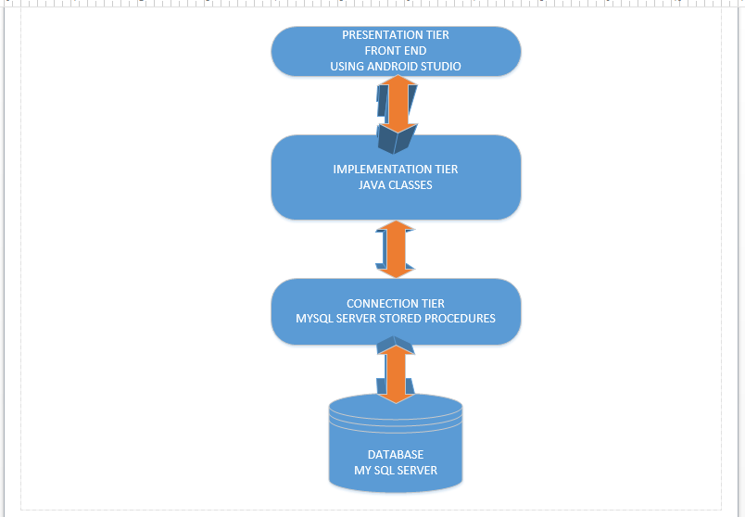
System Architecture

Slide 9
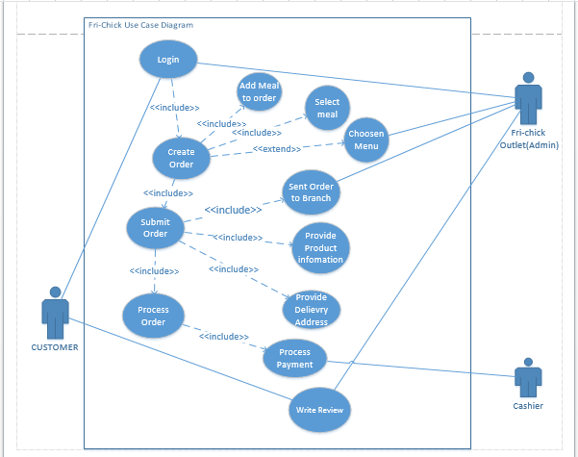
Use Case Diagram

Slide 10
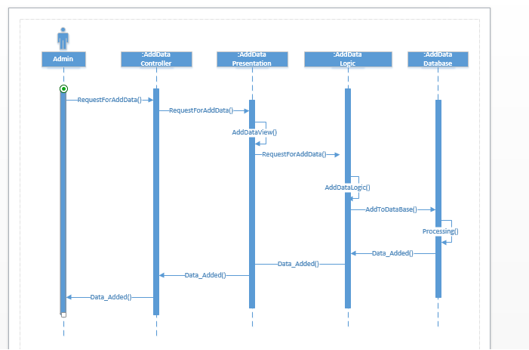
Sequence Diagrams
Add Data:

Slide 11
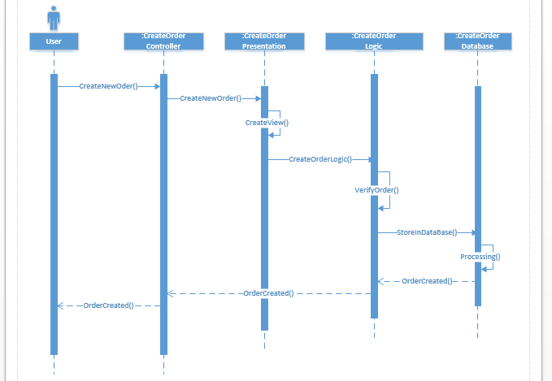
Sequence Diagrams
Create Order:

Slide 12
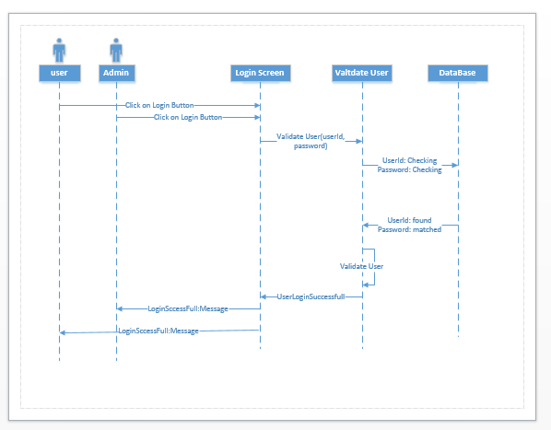
Sequence Diagrams
Login:

Slide 13
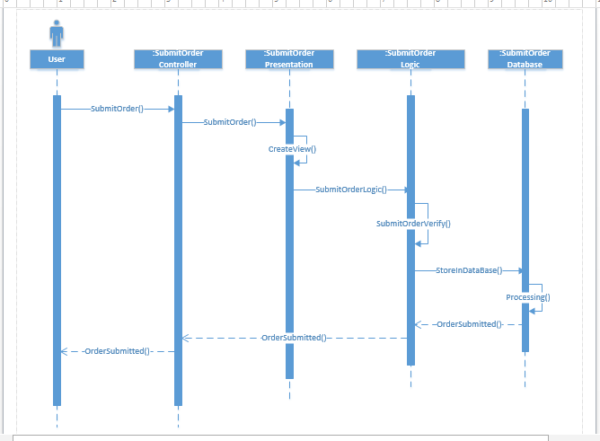
Sequence Diagrams
Submit Order:

Slide 14
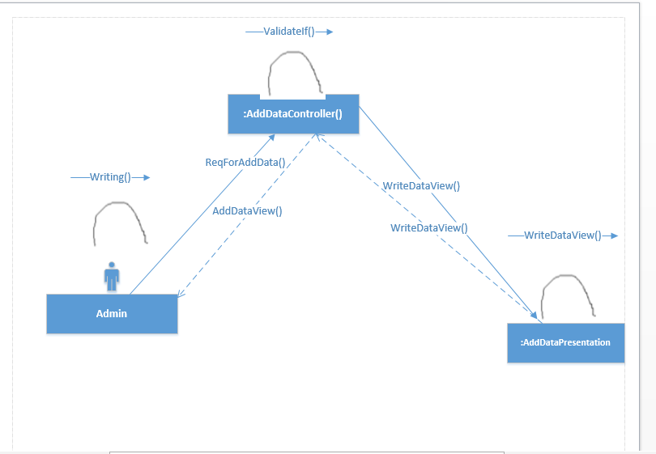
Collaboration Diagrams
Add Data:

Slide 15
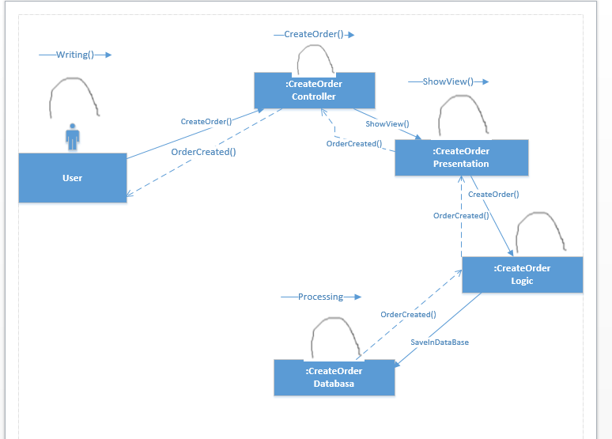
Collaboration Diagrams
Create Order:

Slide 16
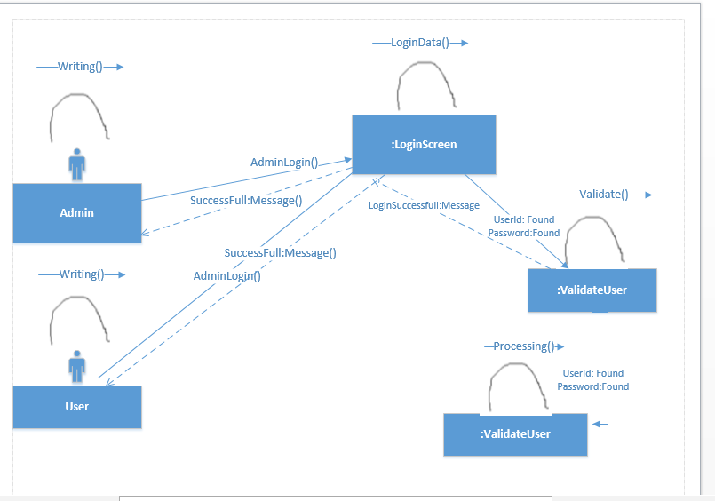
Collaboration Diagrams
Login:

Slide 17
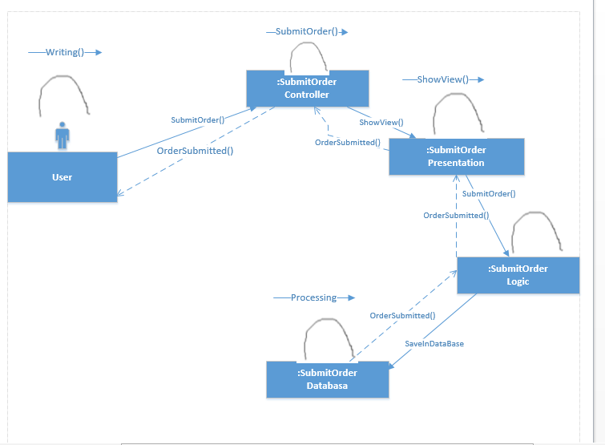
Collaboration Diagrams
Submit Order:

Slide 18
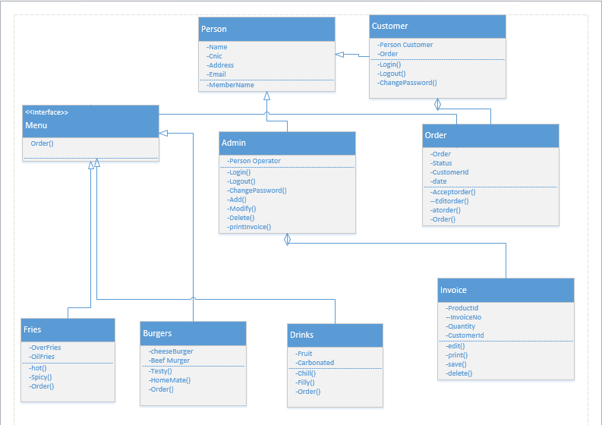
Class Diagram

Slide 19
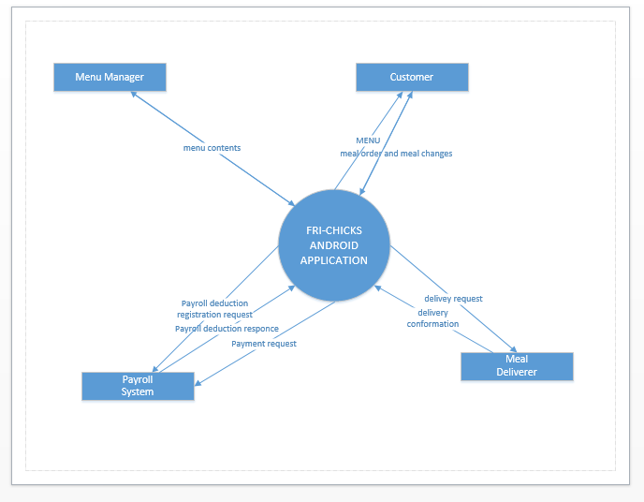
Context Diagram

Slide 20
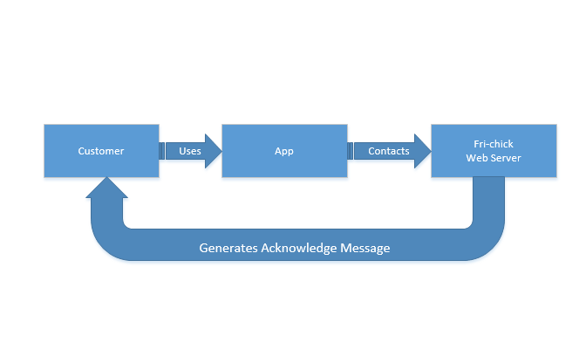
Conceptual Model

Slide 21
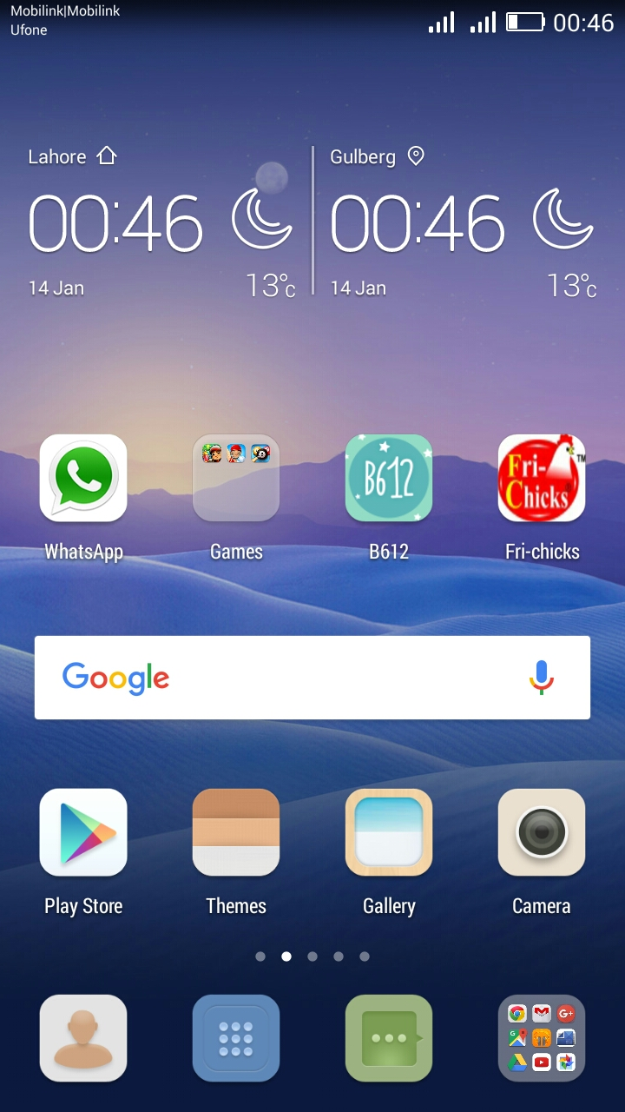

Slide 22
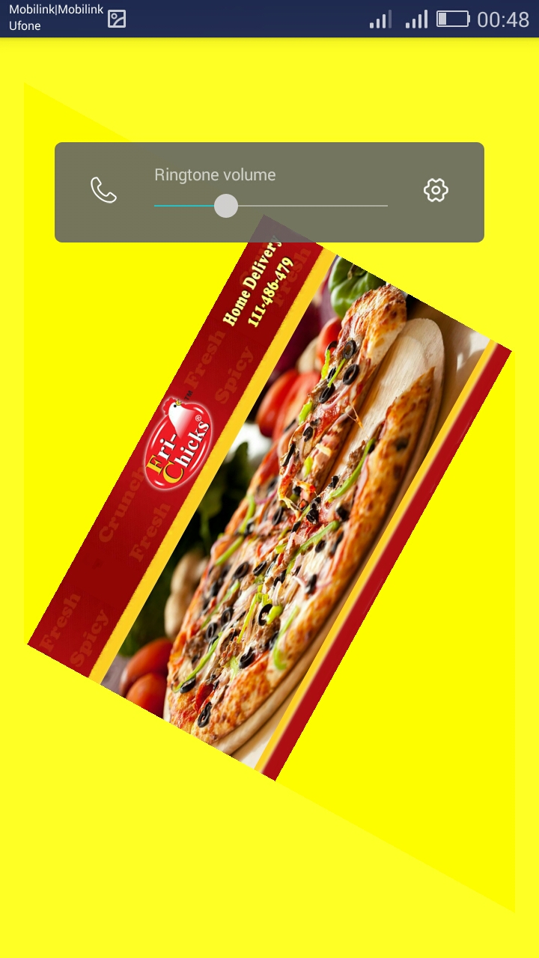

Slide 23


Slide 24
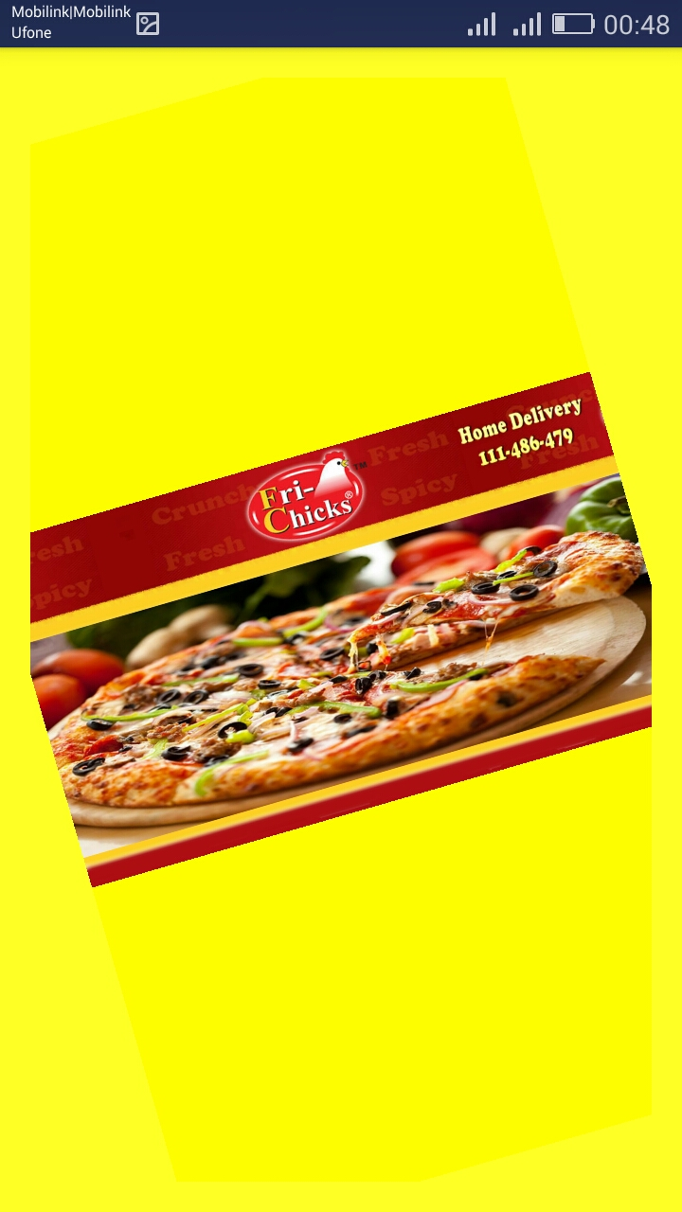

Slide 25
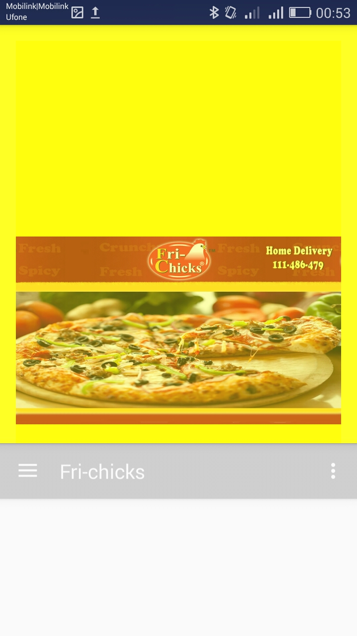

Slide 26
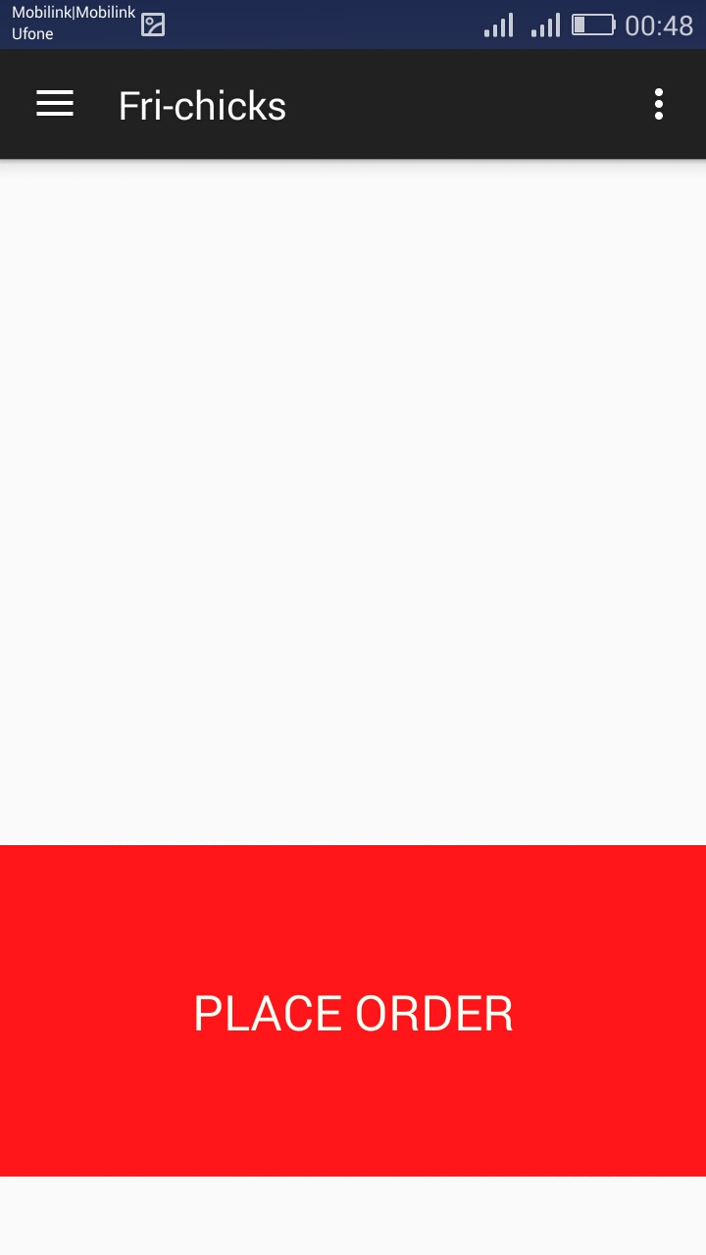

Slide 27
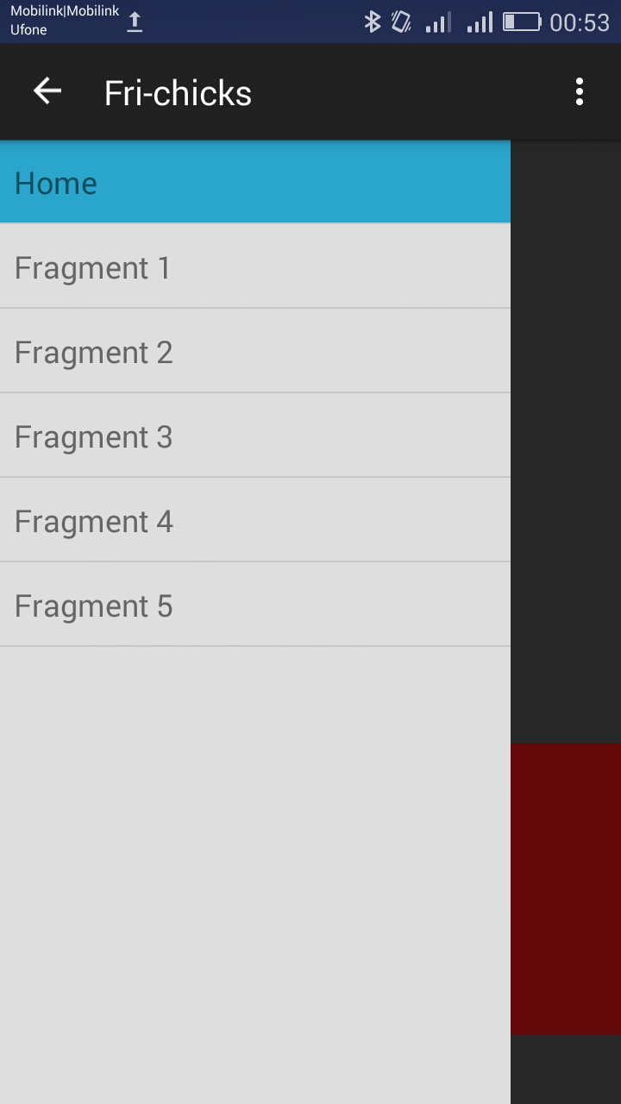

Slide 28


