Slide 1
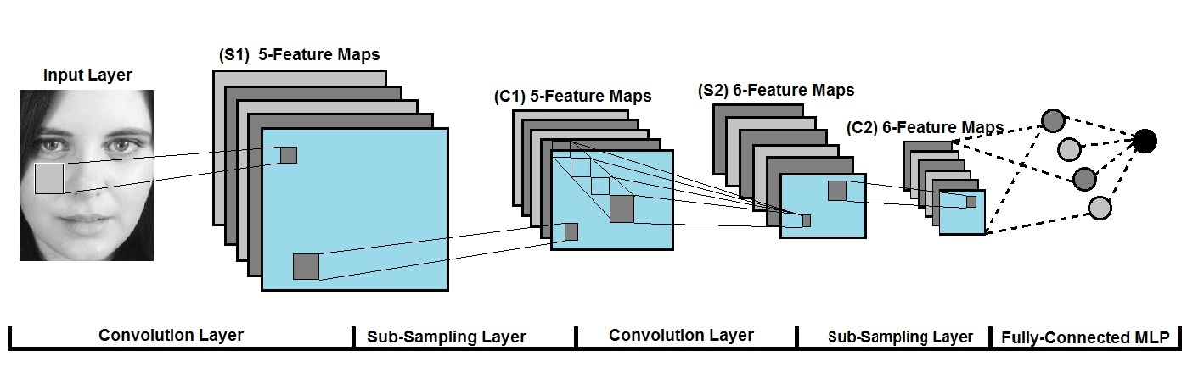
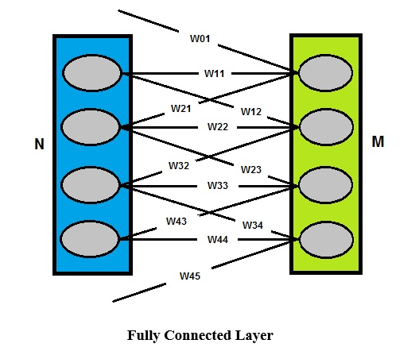
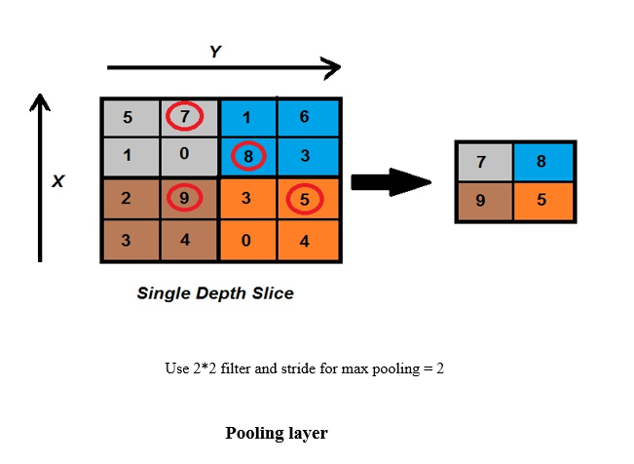
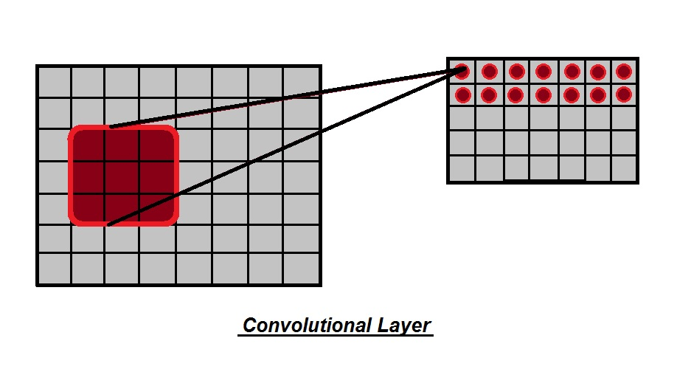
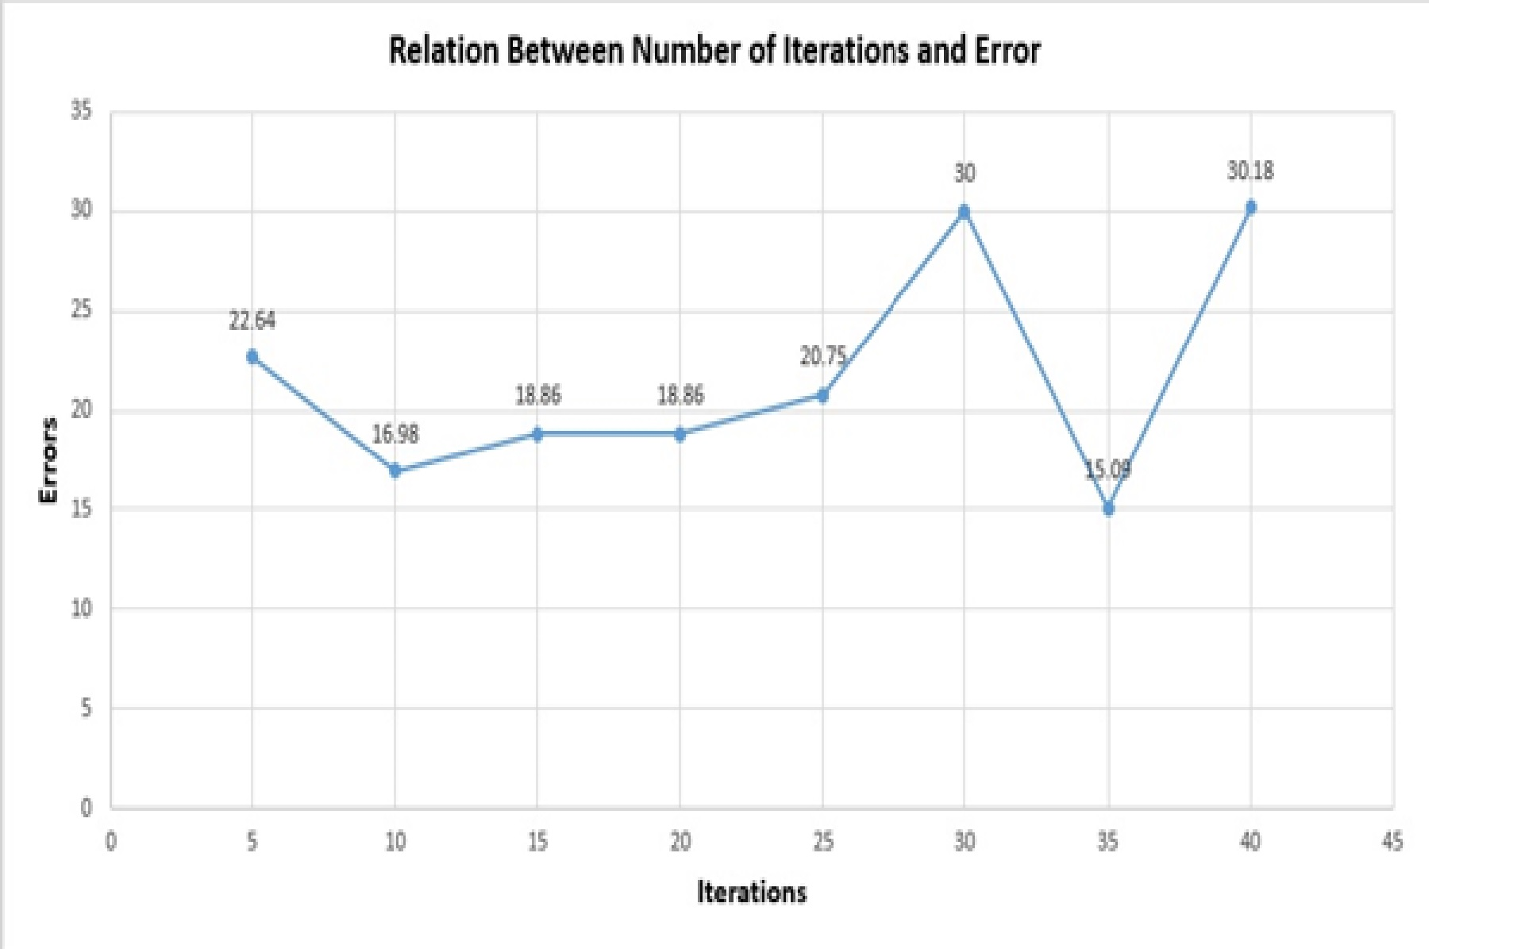
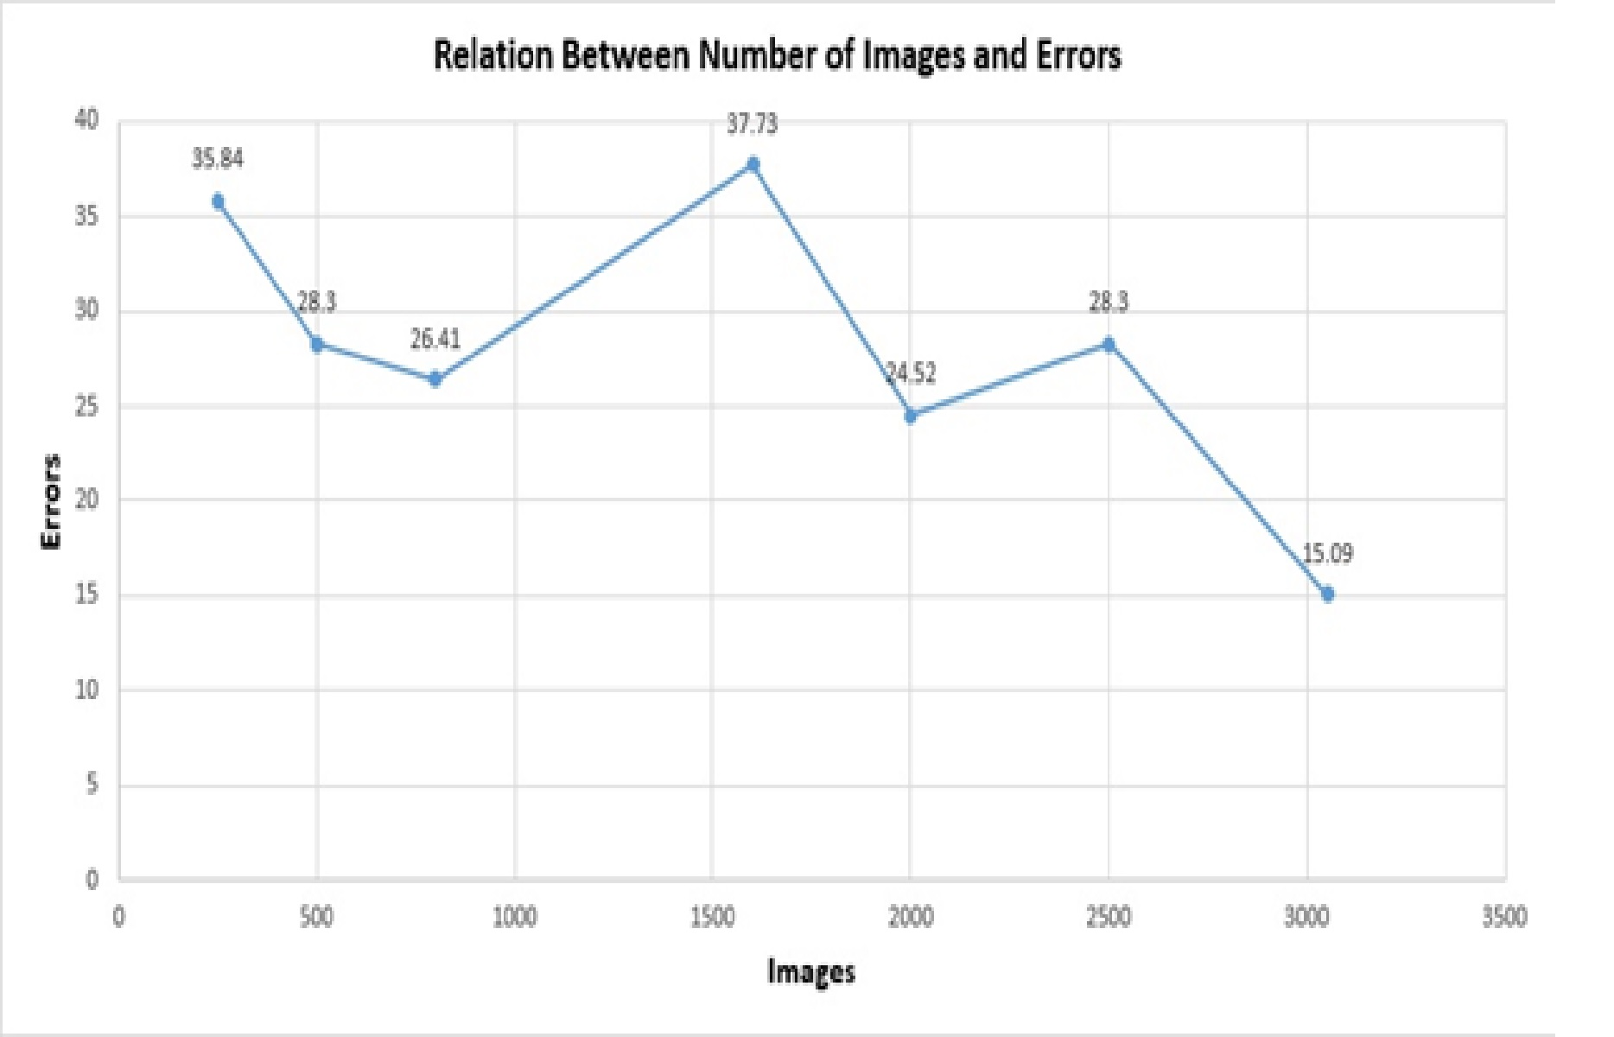
    Race Classification of Asian and Non-Asian People
    Supervisor’s Name: Ms. Tayaba Anjum
    Student’s Name(s), Major(s) or Course Name
Abstract:
Method:
Neural networks are a powerful technology to classify different images. However, there are impressive number of different types of neural networks that are used in the literature and in industry but we used Convolutional neural network (CNN) to classify the images. The proposed procedure takes in the assigned essential characteristic of the face, skin color pattern and other secondary feature from training of images in order to effectively classify races. We use CNN to create a system that classifies facial images that are based on a variety of different facial attributes and classify it into two separate classes. We use 3 convolutional layers. We used 3052 training images of 64*64 pixels and we achieve 85% accuracy.
The solution to the problem of classification can be obtained by the use of convolutional neural networks. The input layers is connected to a convolution layer and convolution layer is connected to subsampling layer or to an output layer. Based on CNN input data on the class to which the input data is most likely. By treating the problem of classification, the number of output nodes is determined by the number of classes and each output node represents a class. In this way, the value of the output node indicates the probability that the input sample falls within one of these tests, determined by the twist of the neural network.
Background:
Faces express the abundance of social signs, including race, age and sexual orientation, all of which have included expanding responsiveness from multidimensional research, such as neuroscience and software engineering. For the examination purposes, it virtues highlighting a few vital purposes of arrangement that have risen up out of psychological research conventions: Perhaps the most visible, yet wrongly comprehended part of race is the basic trap of mistaking race for skin shading. Although broadly researched in brain science groups contrasted and different issues, for example, sexual orientation arrangement and age estimation, race order is less reviewed in the PC vision region.
.
Results:
Conclusions:
Race classification has been performed by many different techniques with accuracy around 96. But no one has worked to solve same problem using CNN. Gender classification has been perform using CNN. So In this work we have solved race classification problem using CNN.
Requirements:
A generic trainable classifier that would be trained by given dataset. Dataset would be containing face images of Asian and non Asian peoples.
Trained classifier should be able to classify any test image in Asian and non-Asian class.
References:
(replace this text with your own) This section can be smaller than 24 point.
Use this section for listing sources /references. The text box is already set up with hanging indents (all lines after the first in each reference are indented.)
Acknowledgements
(replace this text with your own)
If your project was funded (all or part) from grants and/or awards, identify the source(s) of support. You also can acknowledge individuals that provided data and/or feedback to you.

