Slide 1


Slide 2
SMALL SCALE WIND ENERY CONVERSION SYSTEM
Supervised by: Dr.Irfan Ullah
GROUP MEMBERS :
Shahzaib Abbas 14019019030
Nusrat Abbas 14019019028
M.Ahasn Ilahi 14019019038

Slide 3
OUTLINE
Introduction
Problem Statement
Objectives
Implementation
Block Diagram
Hardware Description
Advantages
Future Aspects
Application
Conclusion

Slide 4
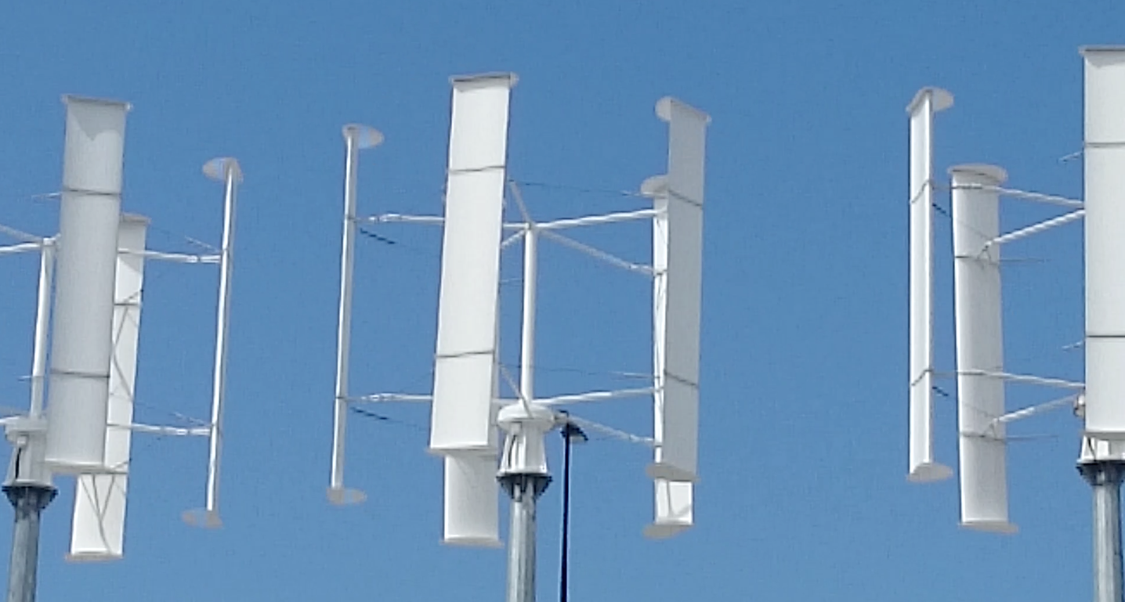
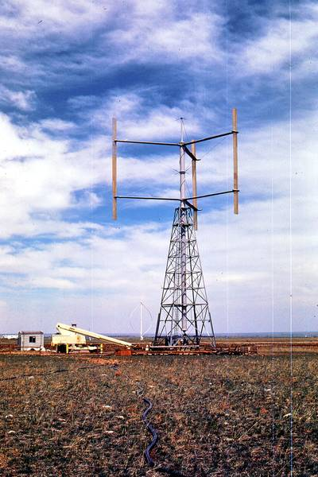
INTRODUCTION
Origin
Darrieus who was a French aeronautical engineer firstly made the VAWT and named it Darrieus Wind Turbine. It has different types like Giromill and Cyclo Turbine. His designs of VAWT was patented in 1926 and implemented in 1931.
Our design of the turbine one of
Modified design of Cyclo Turbine.
Nature of the Project
Methodologies
Our Approach

Slide 5
PROBLEM STATEMENT
Purpose
Approach to Practical System
Wind Turbine Characteristics
Wind Energy Conversion System

Slide 6
OBJECTIVES
Design an Efficient Power generation Source
Utilize the Renewable Energy Resource
Design A System Free from Pollution
Design a Cost Effective System

Slide 7
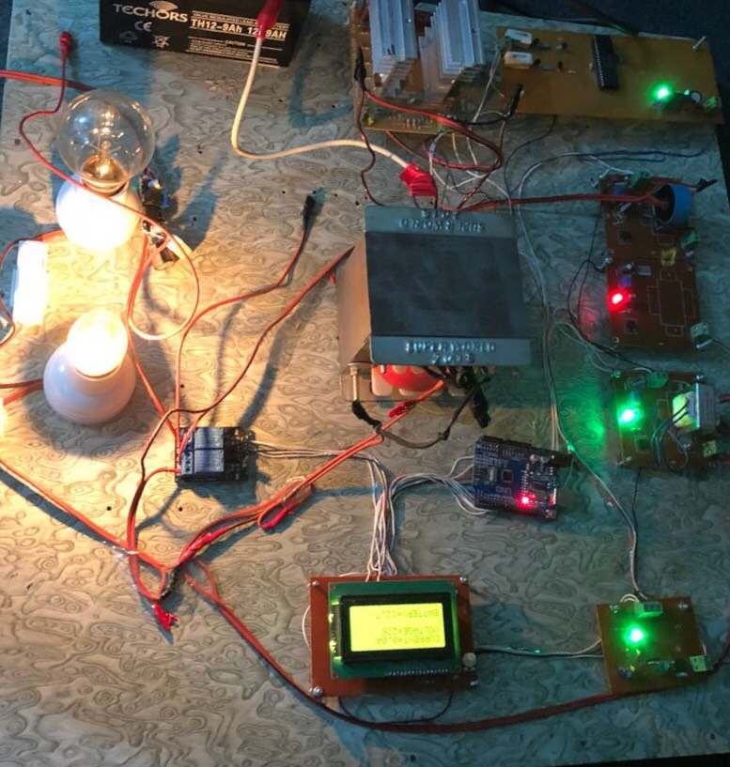
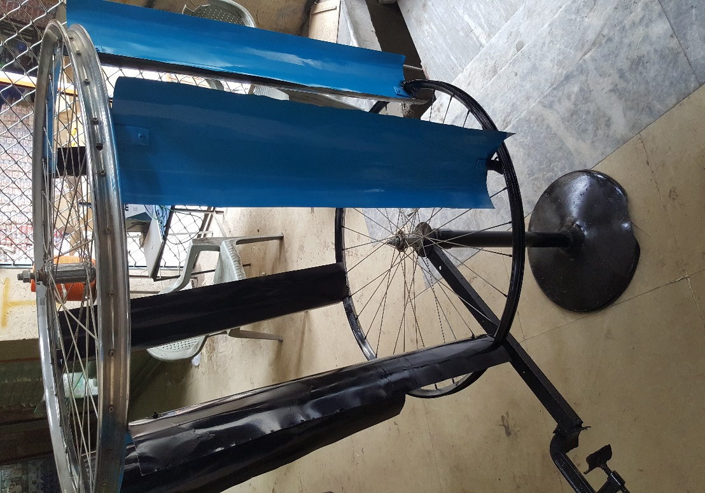
IMPLEMENTATION

Slide 8
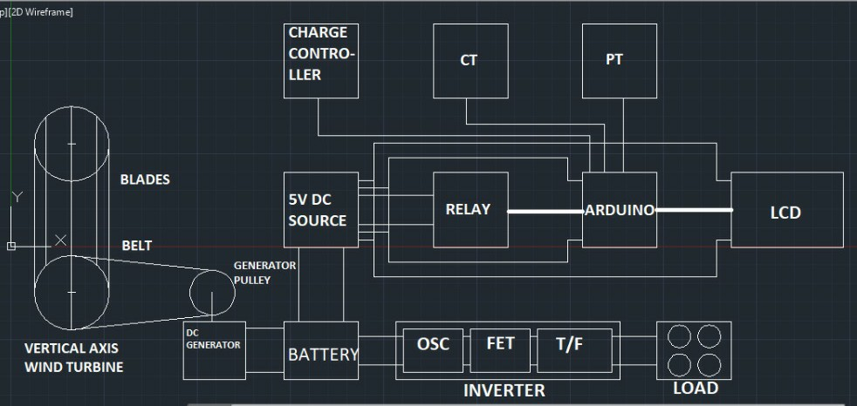
BLOCK DIAGRAM

Slide 9

HARDWARE DESCRIPTION

Slide 10
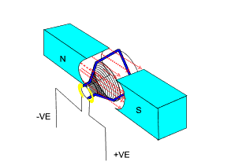
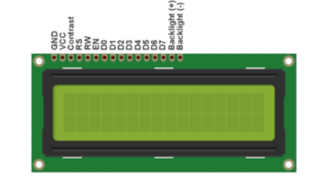
DC GENERATOR
The main function of DC generator is that, it converts the mechanical energy into the electrical energy and that electrical energy is then used for various purposes.
LCD DISPLAY
A 16×4 LCD is basically used to
Display the outputs of the circuits
Which are programmed on different
Types of microcontrollers

Slide 11
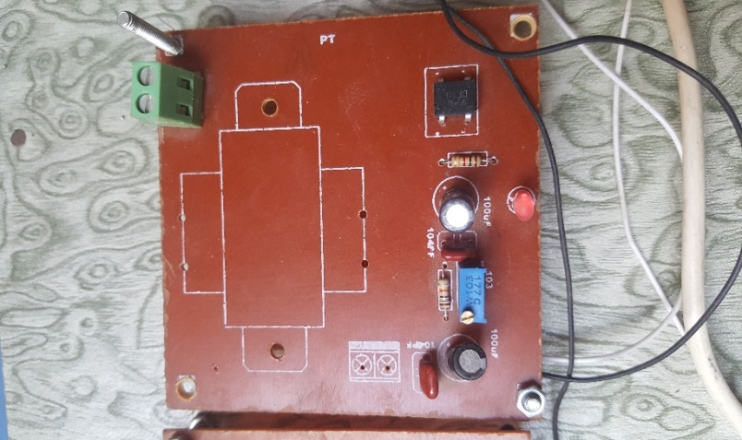
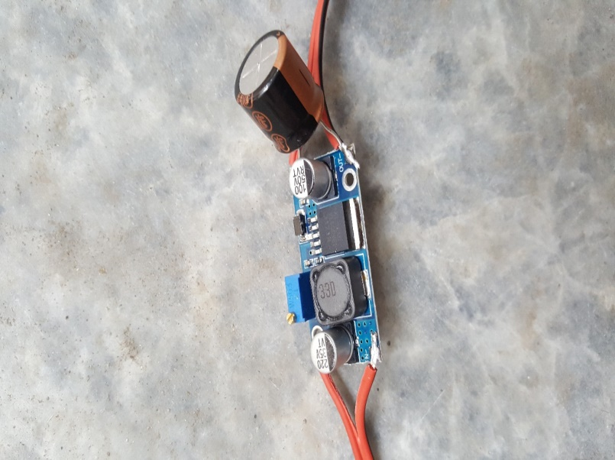
CHARGE CONTROLLER
A charge controller limits the rate at which electric current is added to or drawn from electric batteries. It prevents overcharging and may protect against overvoltage, which can reduce battery performance or lifespan, and may pose a safety risk.
BOOST CONVERTER
A boost converter is used to boost up the
Voltages whenever the voltages are low
Due to low wind speed

Slide 12
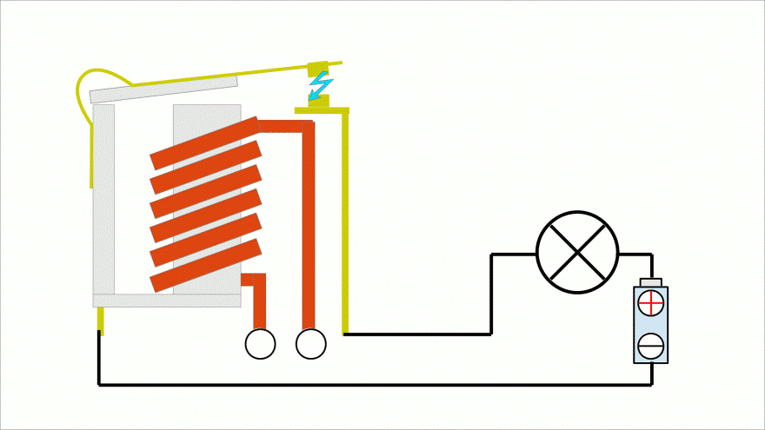
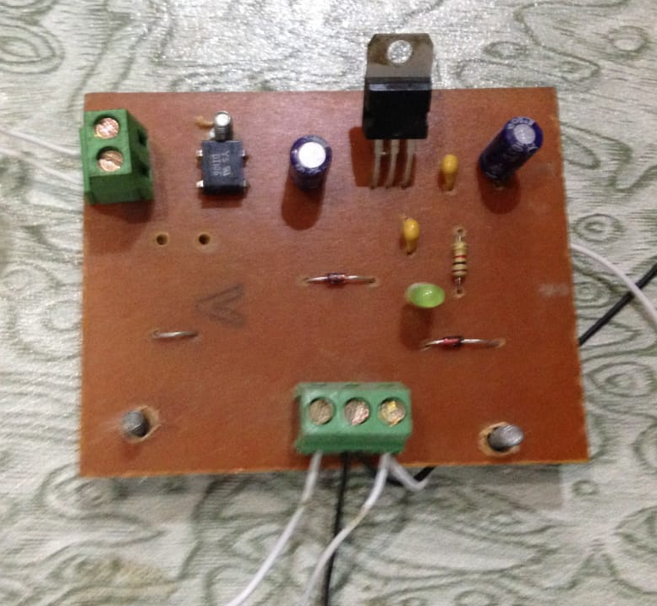
RELAYS
A relay is a device that accepts a voltage to close or open (normally closed or normally open, or both) an internal switch in the relay. That is to say, a relay is a switch that is triggered by a voltage. The relay can control much higher voltages than what it takes to control it.
POWER SUPPLY
Power supply block consists of following units:
Regulator IC-7805
Bridge rectifier circuit
Capacitor as an Input filter
Capacitors as an Output filter
It will get 12V DC from battery and will provide 5V DC to Arduino, LCD and Relays.

Slide 13
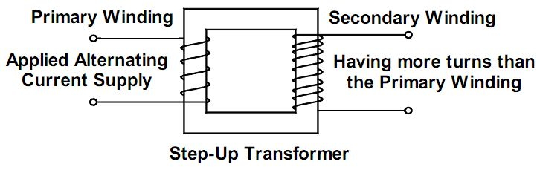
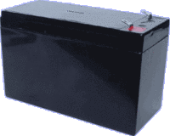
STEP UP TRANSFORMER
Transformers “step up” or “step down” voltage according to the ratios of primary to secondary wire turns. A transformer designed to increase voltage from primary to secondary is called a step-up transformer.
BATTERY
The purpose of the battery in a series circuit is to give the circuit a source of energy. It stores the charges in it on its plates and can be available in different voltages and amperes ratings.

Slide 14
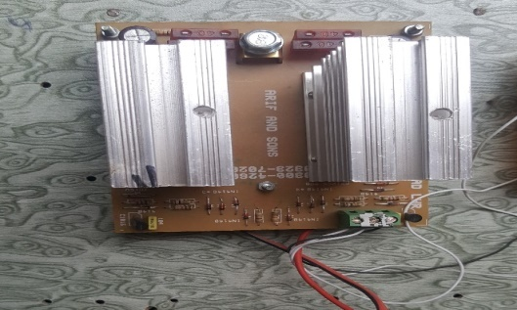
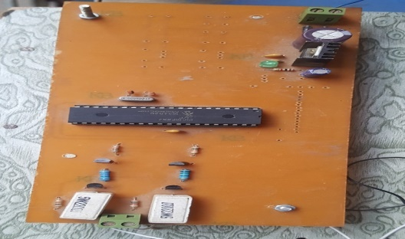
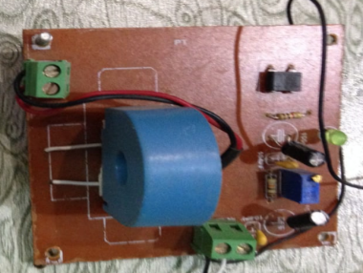
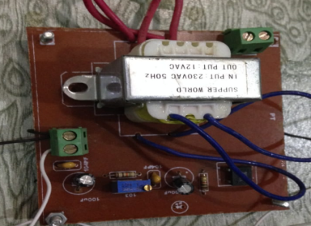
INVERTER
FET Module
It’s main task is to convert the 12V DC to 12V AC for the transformers input.
Oscillator Circuit
It will generate the 50Hz frequency for the transformer input.
CT/PT
CT
PT
Current Transformer
Use for the measurement of current.
Potential Transformer
Use for the measurement of voltage.

Slide 15
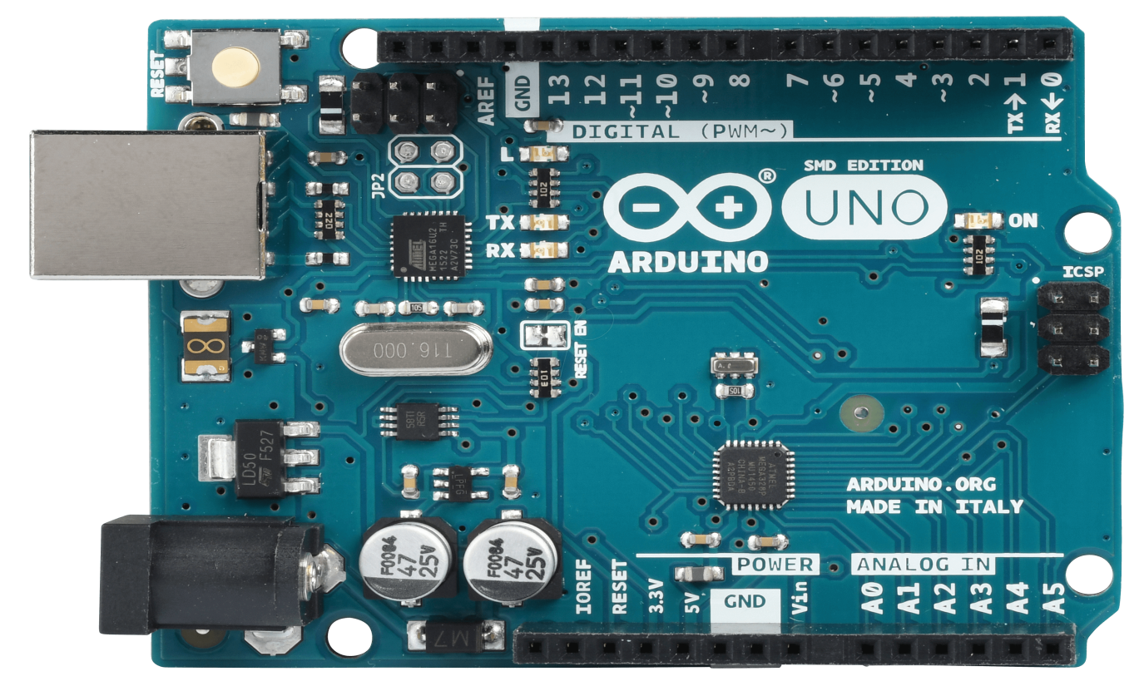
ARDUINO
Arduino is an open-source platform used for building electronics projects. Arduino consists of both a physical programmable circuit board (often referred to as a Microcontroller) and a piece of software, or IDE (Integrated Development Environment) that runs on your computer, used to write and upload computer code to the physical board.

Slide 16
ADVANTAGES
Limitless Resource
Pollution Free
Free Renewable Resource
Low Maintenance Cost
Increase in Electricity
Economical Growth of Country

Slide 17
FUTURE ASPECTS
At the small scale Vertical Axis Wind Turbines are now a days using
widely as these are the most cost effective and reliable source of
renewable resources. Wind turbines are always economical and
now becoming competitive as by the intense growth of the
technology used in hardware designing like power electronics
circuitry of it. New designs of VAWT is still in making as done by us
totally innovative and circuitry of more protections and more
capacity is now making in progress and we can surely make one of
its kind on large scale.

Slide 18
Application
The basic application that urged us to make this project
was at the highways because there the wind speed is
comparatively high than rooftops because of the relative
speed of the cars at highways. Also the rooftops of
commercial and residential buildings can be installed with
small wind turbines with multiple generators to charge the
multiple batteries and to invert the voltage and stepping it
up for the AC loads used.

Slide 19
CONCLUSION
We set our goal to achieve the watts as described above
and that’s what we get by the hardware made by us. So
results were according to our design and checked by DMM
at various parts and measured and calculated values were
compared which were almost the same with negligible
effect. The scope of the project is now cleared as we
planned everything after applying critical thinking on the
problems we faced and after establishing the goals we
achieved it. All of the tasks we performed were performed
with excellence and skillfully in the given time schedule with
almost the same cost we estimated i.e. 20,000

Slide 20


