Slide 1
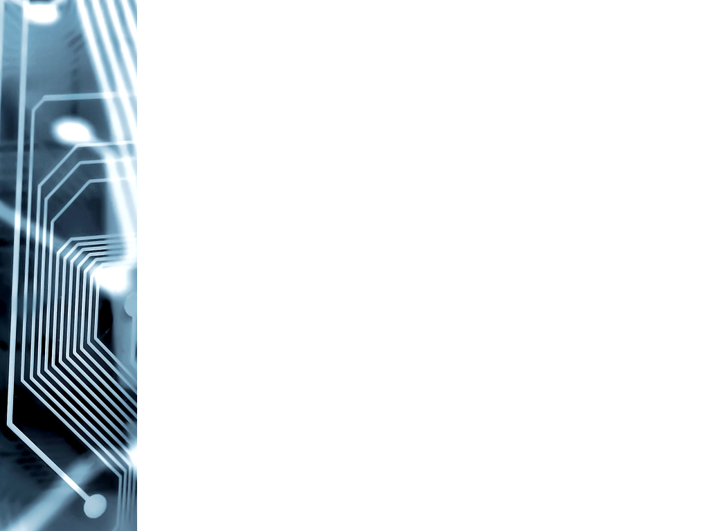

Hadith of the day
“A one who cheats is not from us”
Al-Bukhari

Slide 2
AN INTUTIVE APPROACH FOR THE DESIGN AND IMPLEMENTATION OF OMNIDIRECTIONAL BASED TELEPRESENCE ROBOT
ZAIN UL ABIDEEN ID# 14019019082
MUHAMMAD HUSANIAN JAVED ID# 14019019042
Advised by: Sir. HASSAN TARIQ

Slide 3
Outline
Introduction
Problem Statement
Proposed Solution
Methodology
Implementation/Block Diagram
Results &Testing
Cost Analysis
Applications and References

Slide 4
Introduction
Telepresence
Telepresence robot
History of Tele-Presence
How to use Tele-Presence robot
- control.umtrobot.co
Remotely controlled over the Internet

Slide 5
Problem Statement
Differential Drive Movement
Different channels for video transmission and controlling
No required any external application
Static IP for remote access

Slide 6
Proposed Solution
To use WebRTC
To convert differential movement to omnidirectional
To use DDNS for remote access
To use LIGHTTPD for fast processing and minimizing delay.
Password protection & SSL
Integrated user visualization

Slide 7
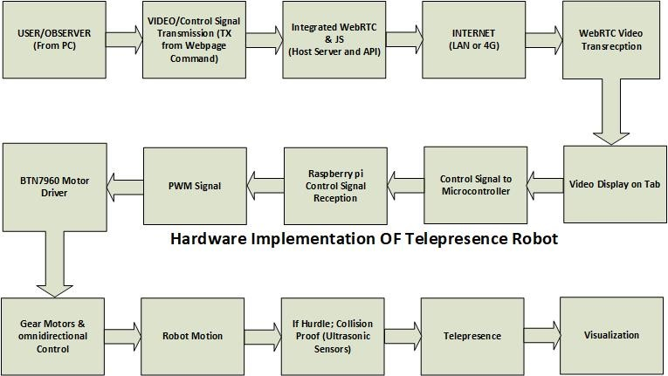
Block Diagram

Slide 8
Methodology
Software Implementation
Hardware Implementation
WebRTC Implementation
Control panel and WebRTC integration
Web server configuration
Design of HTML page
Hosting of Domain
SSL certificate
Password protection of control panel
Installation of Raspian
Installation of LIGHTTPD
Accessing the page on LAN
Purchasing of DDNS
Testing the page from remote location…….

Slide 9
Methodology
Setting Wi-Tribe router for DDNS
Writing CGI Scripts for Arduino control
Implementation of Omni algorithm for Movement

Slide 10
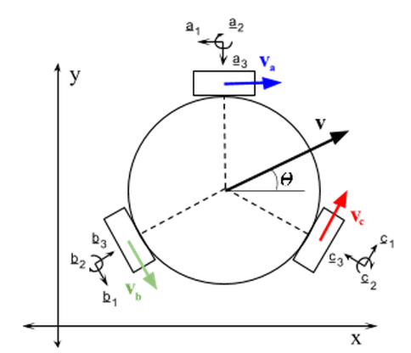
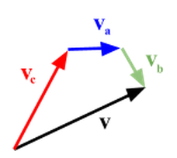
Omni-Directional Control

Slide 11
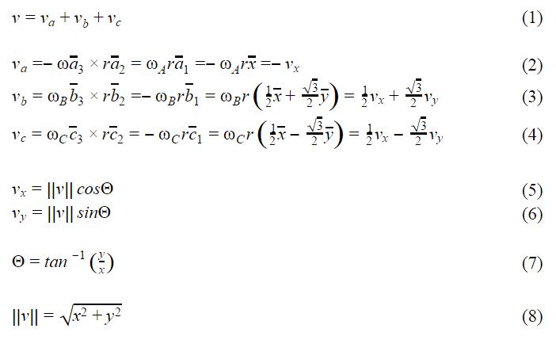
Omni-Directional Control
Reference” Robotics: Control, Sensing, Vision and Intelligence” by Gonzalez
Reference” Theory of applied Robotics Kinematics, Dynamics and control” by Reza N. Jazar

Slide 12
Omni-Directional Control
Reference” Robotics: Control, Sensing, Vision andIntelligence” by Gonzalez

Slide 13
Cost Analysis
Brainstorming for the cost of Tele-Presence
Component | Cost
Omni-Wheels + DC Gear Motors | 16,800
Raspberry pi + Arduino | 6,600
Hosting Domain +SSL | 10,000
Driver + Battery +Router | 11,000
Tab+ Chassis + DDNS | 20,000
Total: | 64,400

Slide 14
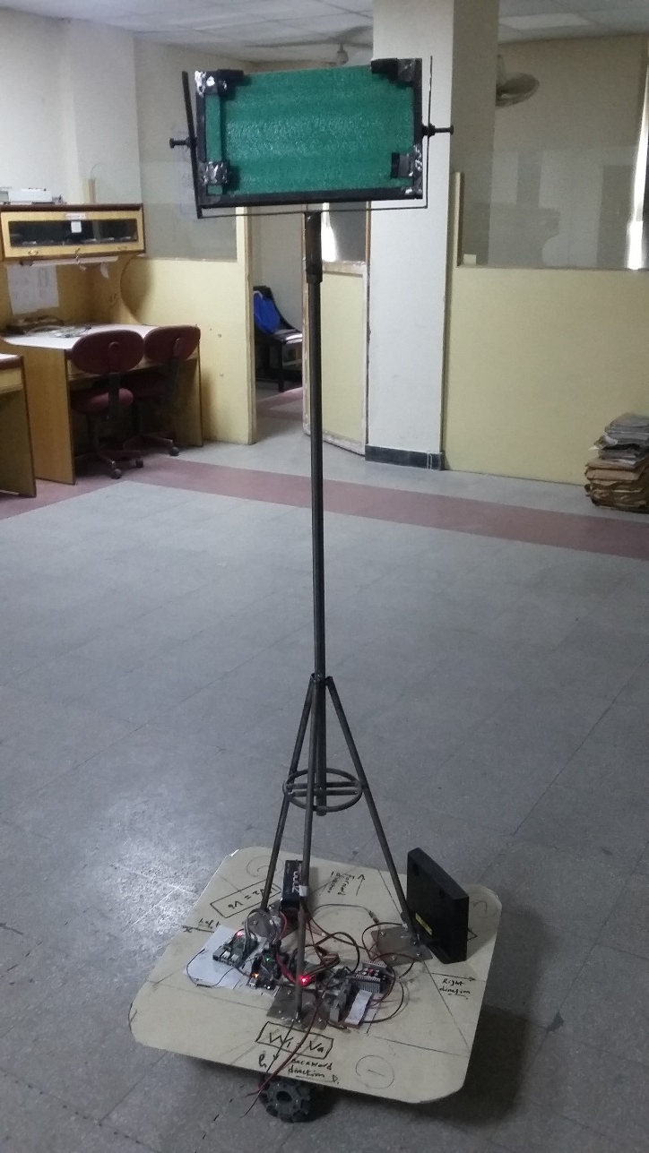
Tele-Presence Robot

Slide 15
Applications
To facilitate in the offices
Distance leaning education
To conduct interviews and invigilation
For medical assistance in the hospitals
To reduce Co2 (Green Globalization)
Live Lectures and presentation
Entertainment and exhibition

Slide 16
Thanks
Again we thanks all of you for the presence and supporting comments are welcome.
JazakALLAH…!

Slide 17
Testing/Demo
Control.umtrobot.co
Umtrobot.co

