Slide 1


Slide 2
Hightail Runner
A Fantastic Journey Towards Fun

Slide 3
PROJECT ADVISORS
Miss Sadia Khalid
Ma’am Tanzeela Shakeel

Slide 4
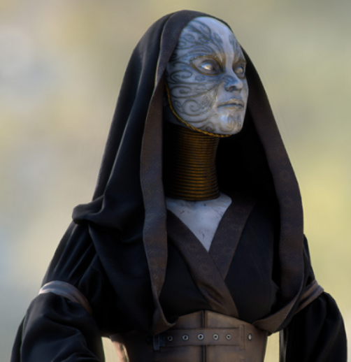

The Game Engine
Unity 2D

Slide 5
PURPOSE
HIGHTAIL RUNNER IS A NEW GAME, FULL OF FANTASY WITH SMOOTH CONTROLS AND PLENTY OF FREE-RUNNING FUN. YOU CAN HELP THE CHARACTER, TRICKY & FRESH ESCAPE FROM THE GRUMPY HURDLES.
MAIN PURPOSE OF THE APPLICATION IS TO PROVIDE AN INTERFACE FOR THE PEOPLE WHO WANT TO ENJOY THE NEW SEASON OF ENTERTAINMENT. THIS GAME WILL ALLOW THE USERS TO ACTIVE THEIR MIND FOR EACH MOVEMENT ON THE WAY.

Slide 6
SCOPE
HIGHTAIL RUNNER IS A MOBILE AS WELL AS A DESKTOP APPLICATION THAT PROVIDE THEIR USERS ENTERTAINMENT AND PEACE OF MIND AFTER HARD WORK IN OFFICES AND STUDIES. PEOPLE CAN PLAY THIS GAME FREE OF COST WITH OFFLINE MODE.
MAIN OBJECTIVE OF THIS PROJECT IS TO CONSTRUCT A QUALITY GAME WITHIN ONE YEAR BY PROVIDING AN INTERESTING, ENTERTAINING AND CHALLENGING GAME TO OUR USERS THROUGH DIFFERENT ATTRACTIVE INTERFACES.

Slide 7
FUNCTIONAL REQUIREMENTS
NON-FUNCTIONAL REQUIREMENTS
HURDLES EXISTENCE
AVATAR MOVEMENT
MUSIC/SOUND TONE
TOUCH SCREEN QUALITY
USABILITY REQUIREMENTS
HARDWARE ACCELERATION
RELIABILITY SUPPORTABILITY
PERFORMANCE REQUIREMENTS

Slide 8
USER EXPERIENCE GOALS
FUN
SATISFYING
ENTERTAINING
HELP & SUPPORT
CLEAR LANGUAGE
PORTABLE
SIMPLICITY
ENGAGING
ATTRACTIVE
REWARDING

Slide 9
Documentation
Project Methodology
Further, we have done this project in two milestones:
DEVELOPMENT
USE-CASES
CLASS DIAGRAM
DATA FLOW DIAGRAM
DESIGNING
IMPLEMENTATION
TESTING PHASE

Slide 10

Project Breakdowns
Testing and Optimization
Development + Deployment
Project Documentation
Modeling
Analyzing Requirements
Comprehensive Study

Slide 11
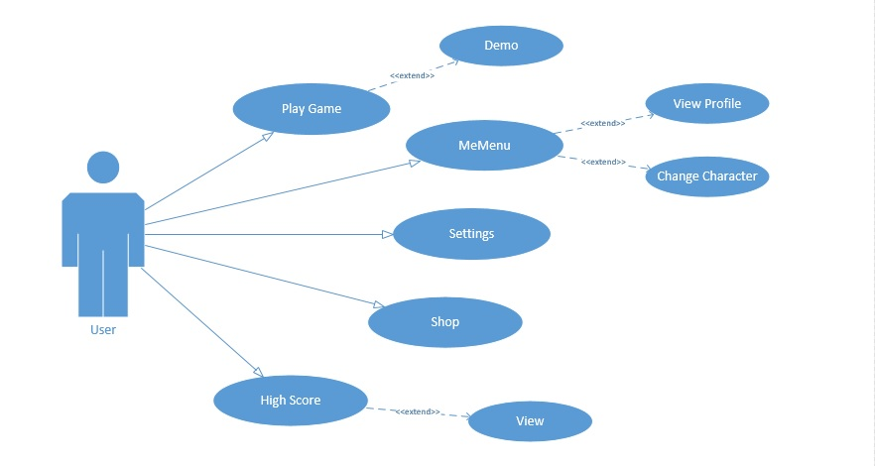
Use-case Diagram

Slide 12
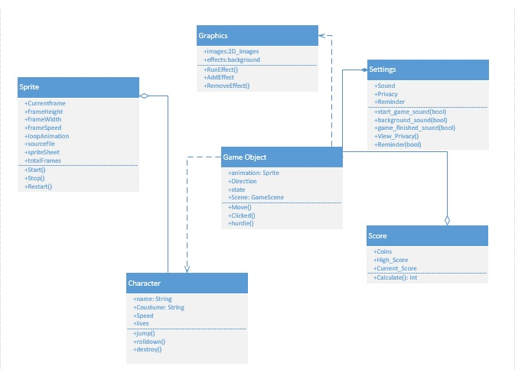
Class Diagram

Slide 13
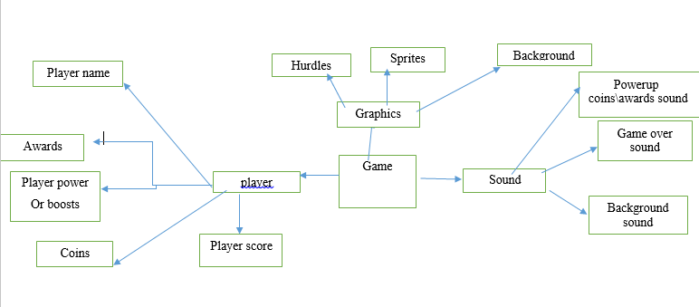
System architecture

Slide 14
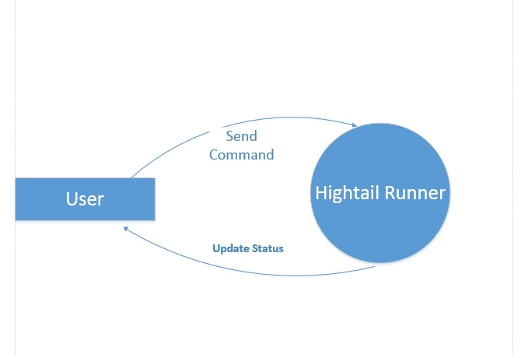
Data Flow Diagram (level 0)

Slide 15
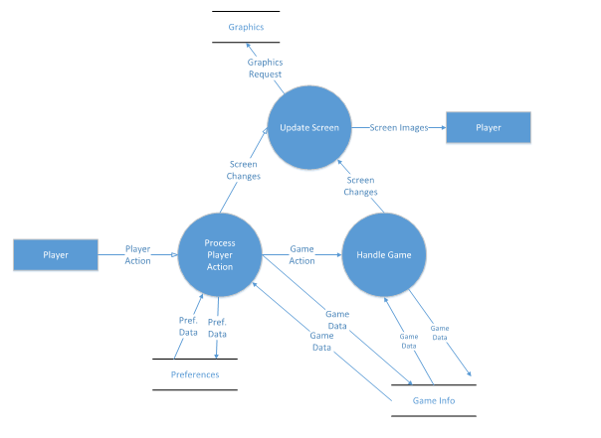
Data flow diagram (level 1)

Slide 16

Main Menu

Slide 17
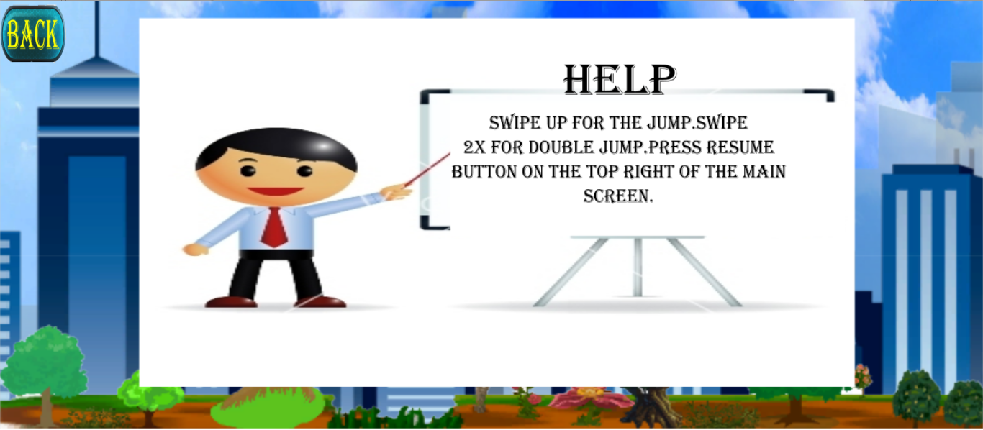
Help & Support

Slide 18

Score boosters

Slide 19
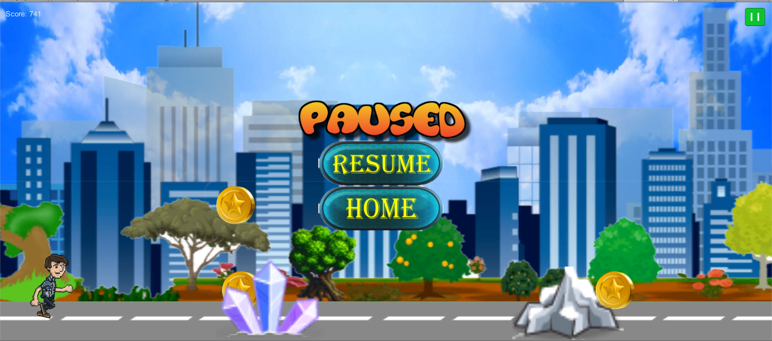
Pause Game

Slide 20

Game Over

Slide 21
