Slide 1


Slide 2

A Military SPY ROBOT
A project by:
Muhammad Haseeb 13018019110
Sultan M.Salah Ud Din 13018019068
Ibetsam Ellahi 13018019067
Muhammad Bilal Shafiq 13018019176
Supervised by:
Sir Saleem Ata

Slide 3
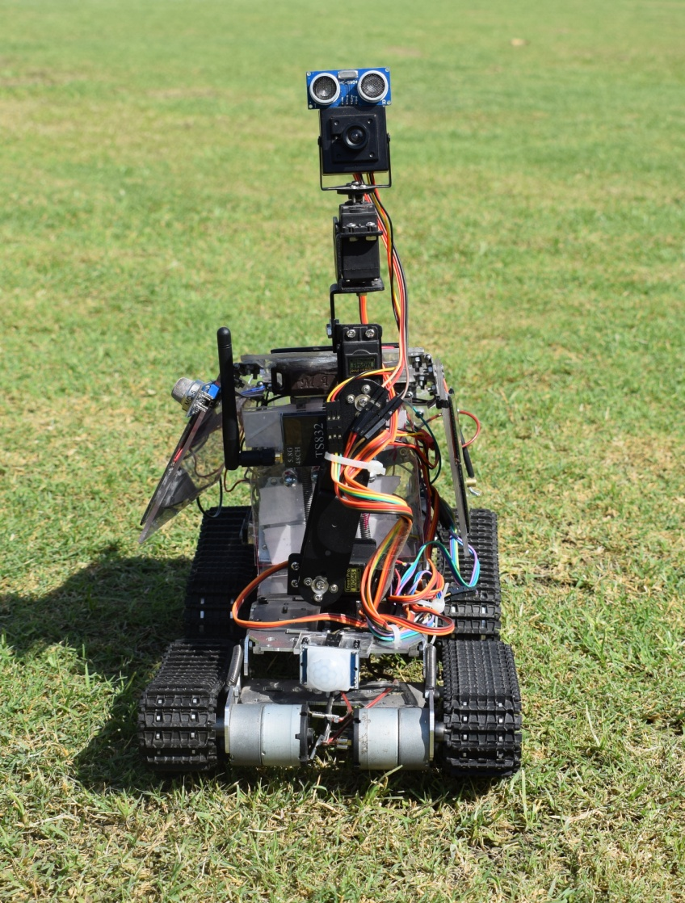
CONTENTS
Introduction
What does a SPY do?
Arduino
Bluetooth
Buck Boost Converters
Hybrid Feature
Robot Hardware
Sensors
FPV Wireless Module
Implementation Strategy
References

Slide 4
Introduction
Definition
Flexibility
Arduino
Sensors
Robotic Arm
Long Range
Short Range
Android App

Slide 5
What does a Spy do?
As we are making a spy robot, the first question is
what does a spy do? Spies do many jobs. One work
for their own country to keep it safe from the
enemies and some of them are silent secret killers
and some protect their homeland from enemy
spies. Spies spy for many reasons. High salary attracts
many of them. Some work because they just love the
excitement involved in this type of work. Main job of a
spy is to collect the information that is required for the
company or any other firm.

Slide 6
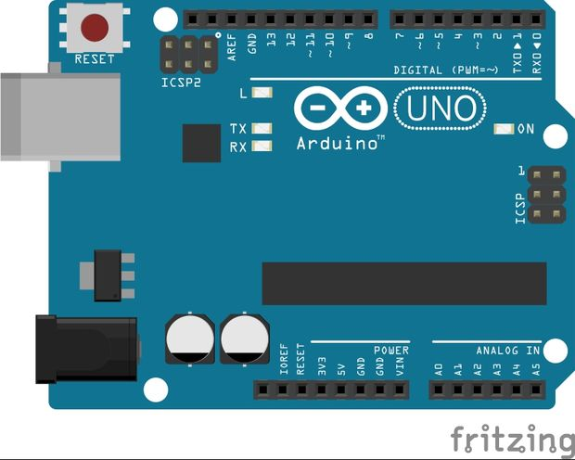
ARDUINO
Arduino is an open-source stage utilized for building hardware ventures. Arduino comprises of both a physical programmable circuit board (MICROCOTROLLER) and a bit of programming, or IDE (Integrated Development Environment) that keeps running on your PC, used to compose and transfer PC code to the physical board.
Arduino is an open-source stage utilized for building hardware ventures. Arduino comprises of both a physical programmable circuit board (MICROCOTROLLER) and a bit of programming, or IDE (Integrated Development Environment) that keeps running on your PC, used to compose and transfer PC code to the physical board.

Slide 7
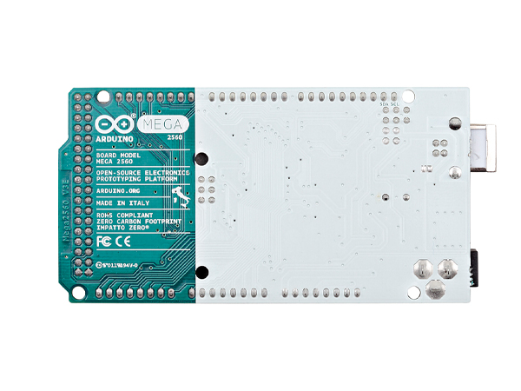
TYPES
There are two types of arduino.
Arduino Uno
Arduino Mega 2560
We use Arduino UNO for the operation of servo
motors while Arduino MEGA is used for all other
functions.
TYPES
There are two types of arduino.
Arduino Uno
Arduino Mega 2560
We use Arduino UNO for the operation of servo
motors while Arduino MEGA is used for all other
functions.

Slide 8
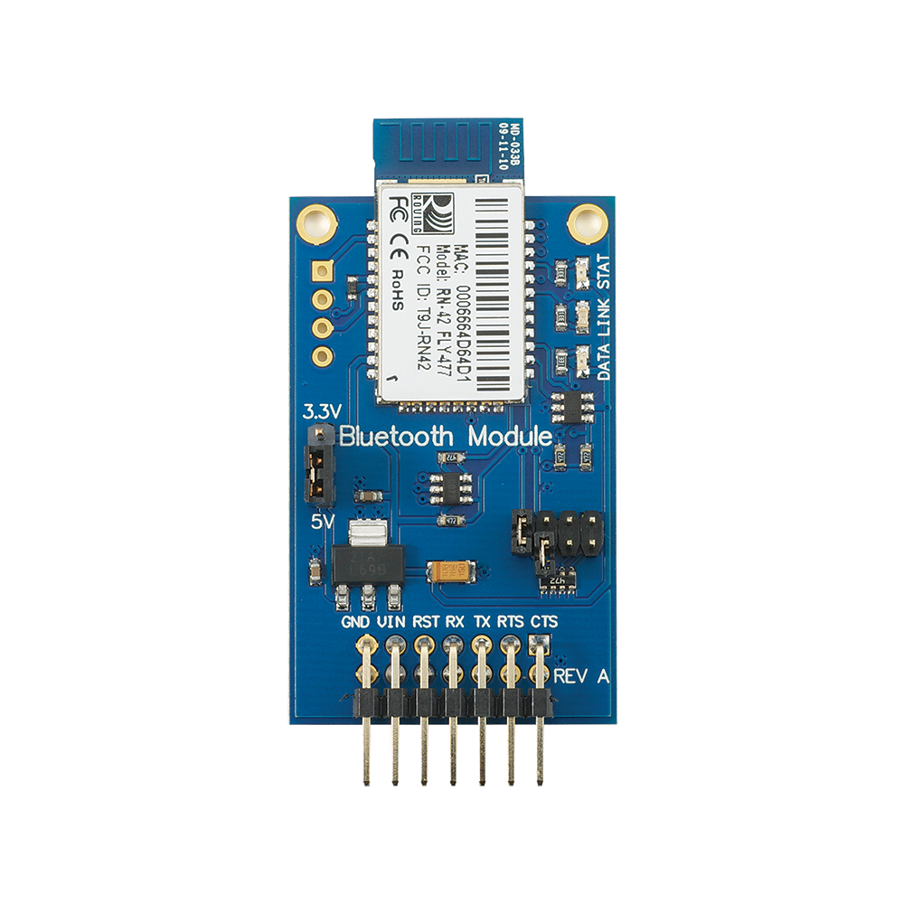
Bluetooth
Bluetooth is, with the infrared, one of the
significant remote innovations created to
accomplish WPAN(wireless personal area network).
Bluetooth is a remote LAN
innovation used to interface gadgets of various
capacities, for example, phones, cameras,
printers etc.
We control our robot through wireless communication
from a long distance. Bluetooth cannot have long
distance range. We can use Bluetooth module in our
project for checking and controlling robot in short range.

Slide 9
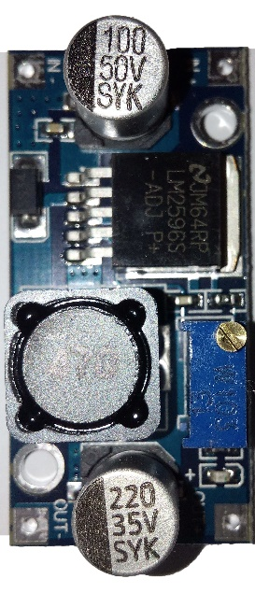
Buck Converter
Buck converter is a power electronic device that
is used to step down DC voltage with better
efficiency.
We are using LM2596s Buck converter.

Slide 10
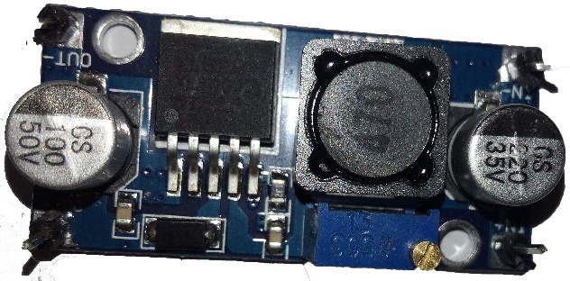
Boost Converter
Boost converter is a power electronics device
which is used to step up the DC voltage.
We have used XL6009 module for Boosting.

Slide 11
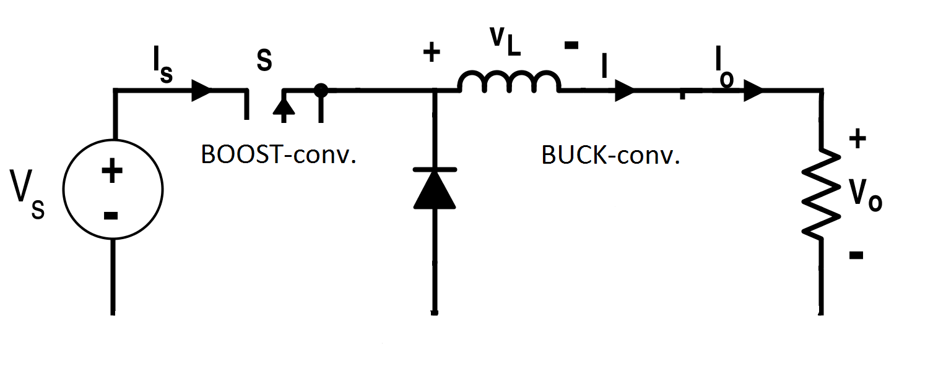
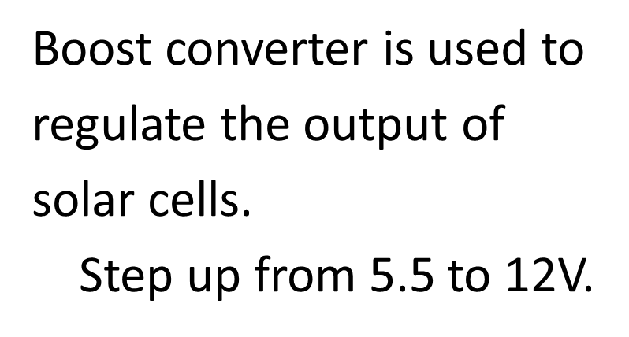
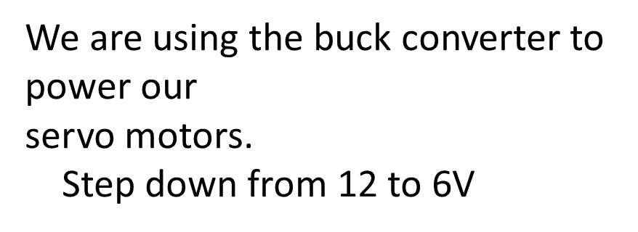

Slide 12
Hybrid Feature
Solar Panel is basically a panel that absorbs the
sun rays as source of energy for producing an
amount of electricity.
A solar setup consists of :
Charge Controller
A battery
An Inverter
Solar Cells

Slide 13
Hybrid Feature
In our robot, we have placed 9 solar cells on the
plastic wings. They are connected in series.
They can give 5.4V during day time.
Solar cells will give power to the battery. This
overcomes the problem of charging during
spying. When the battery level falls down at work,
then solar cells will charge the battery. In this way,
our spying will not be interrupted.

Slide 14
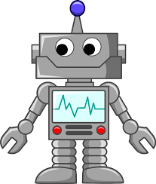
Robot Hardware
Robotic Chassis
Robotic Arm
Servo Motors
Plastic Enclosure

Slide 15
Robotic Chassis
Size: 383mm * 204mm * 84mm (L * W * H)
Operating voltage: 9 to 12V
Description: The chassis body and wheel architecture uses all-metal production to make the chassis solid, stable and beautiful.
Four strong powerful motors are installed for the grip of the wheel on a plane road, on the ramp or on any kind of surface . It can move forward, backward, turn left, turn right, etc . It can run smoothly and unhindered.
The front part of the chassis can stand freely, according to the angle of the car ramp to adjust the overall balance of the chassis. It is totally flexible.

Slide 16
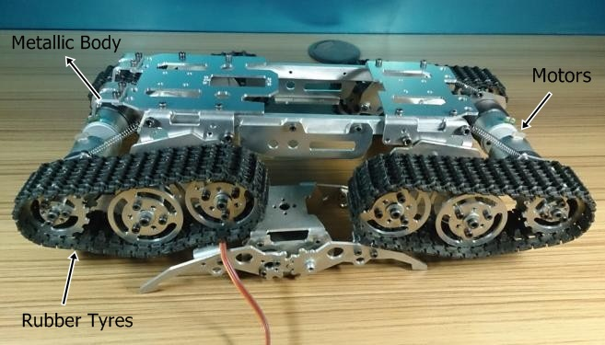
Robotic Chassis
Design and Configuration:

Slide 17
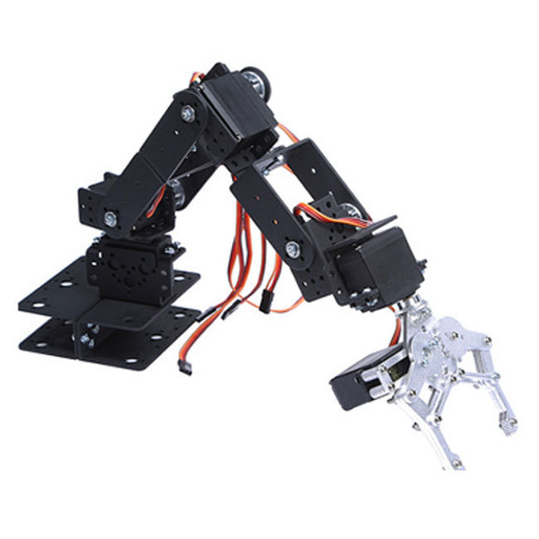
Robotic Arm
A robotic arm is like a human arm.
It can be programmable.
The robotic arm we use in
our project is 3-Dimensional.
We can rotate it in any direction we want, i.e.
up , down, left, right.
Four servo motors are attached with it. We can
control it by rotating the servo motors connected to
each joint.

Slide 18
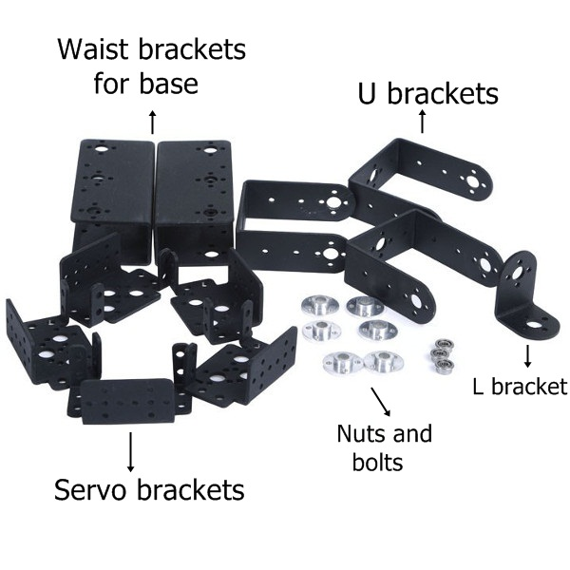
Robotic Arm
Configuration:

Slide 19
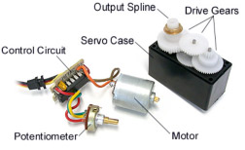
Servo Motors
Servo motors are commonly an accumulation of
four things:
1. DC motor
2. Gearing set
3. Control circuit
4. Position-sensor (potentiometer).

Slide 20
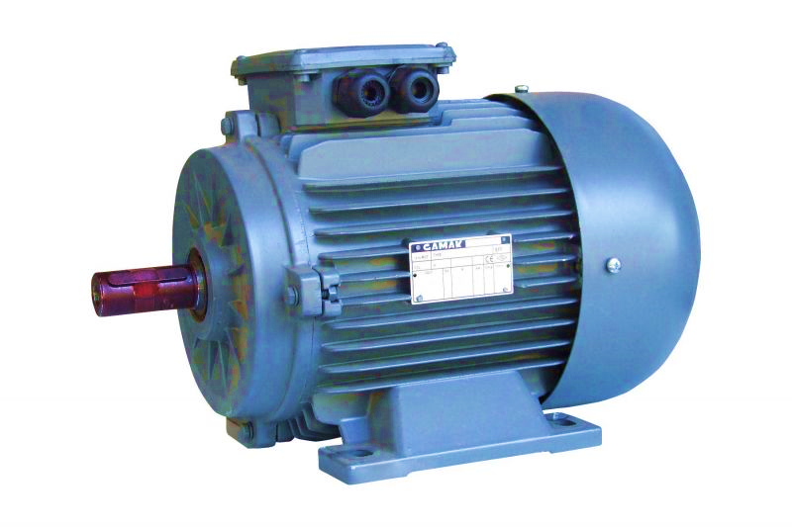
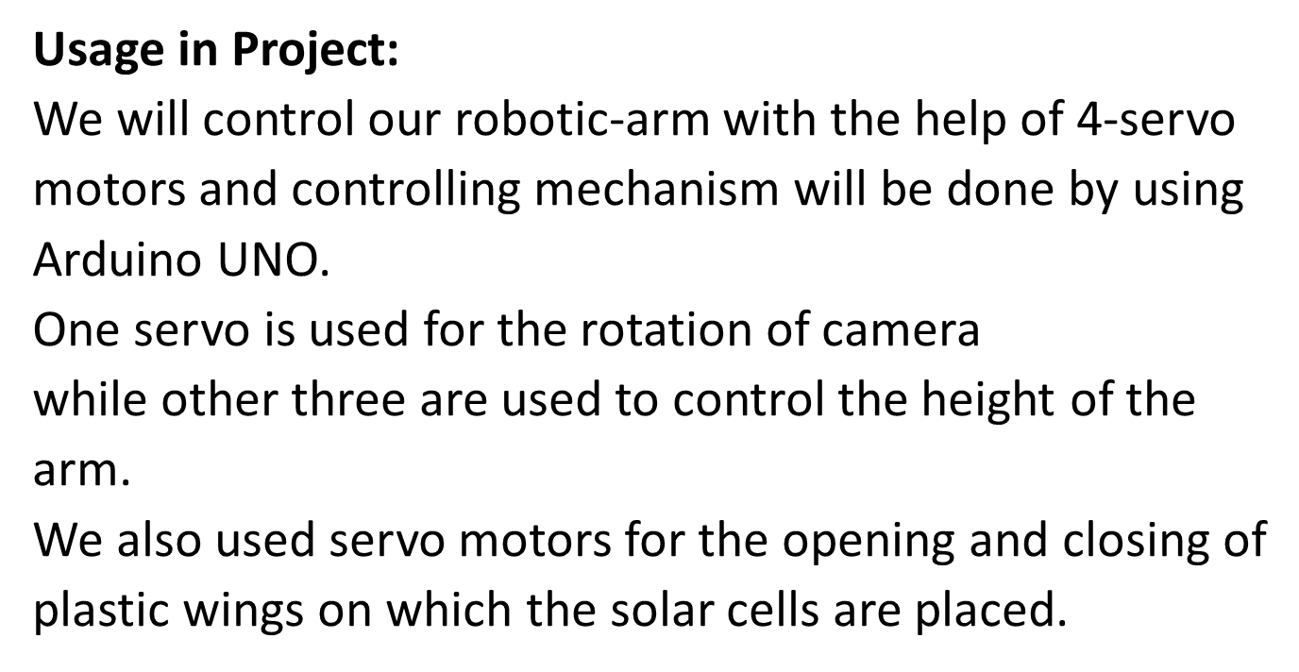
Servo Motors

Slide 21
Plastic Enclosure
We have build a plastic enclosure to protect and place all the circuitry in it.
Arduino MEGA , Arduino UNO , motor drivers, buck and boost converters, additional wires etc are placed in it.
On this housing, we have placed 9 solar cells.
This plastic enclosure is flexible. It has 2 wings.
We open and close these wings with the help of a servo motor.

Slide 22
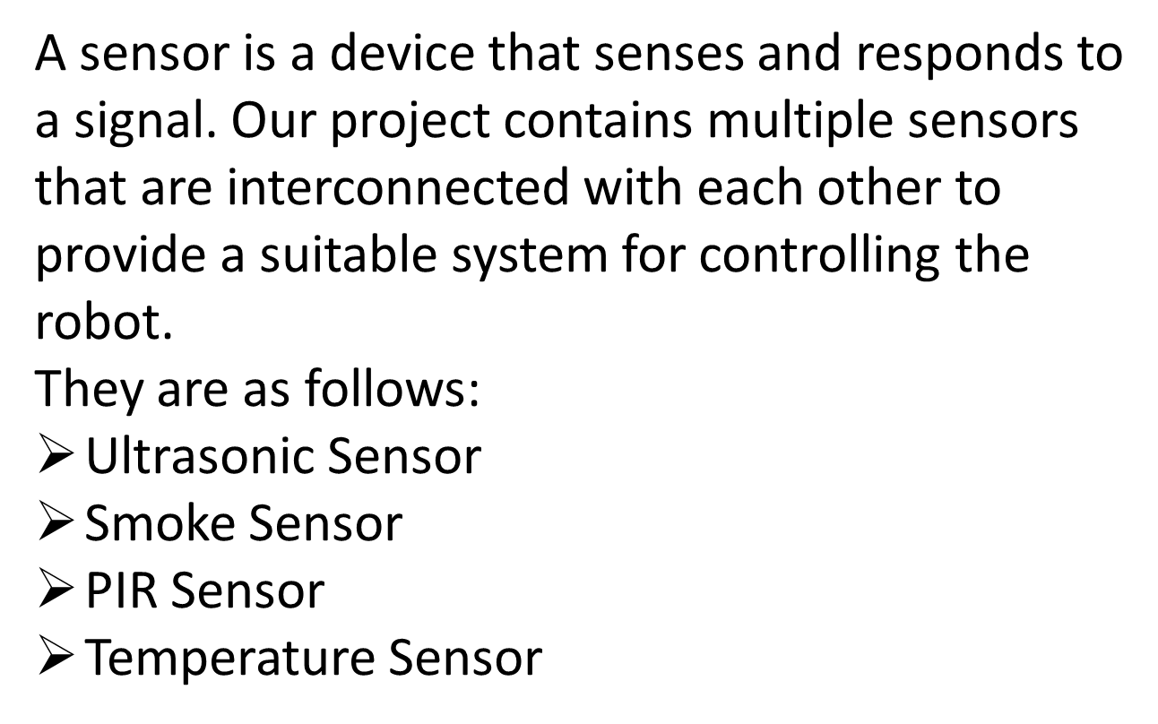
SENSORS

Slide 23
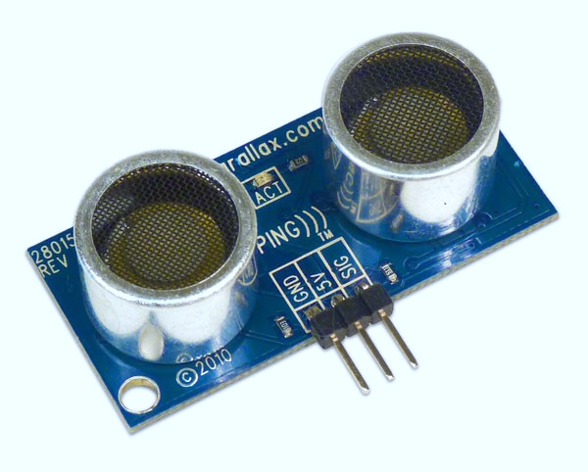
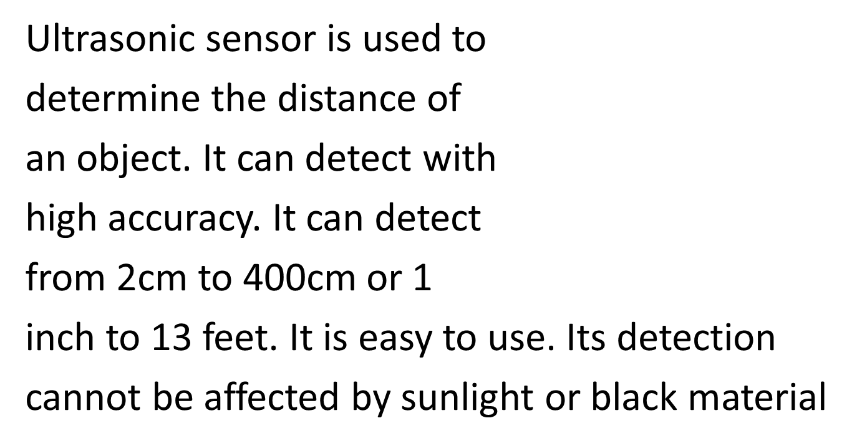
Ultrasonic Sensor
ect with
high accuracy. It can detect
from 2cm to 400cm or 1
inch to 13 feet. It is easy to use. Its detection
cannot be affected by sunlight or black material.

Slide 24
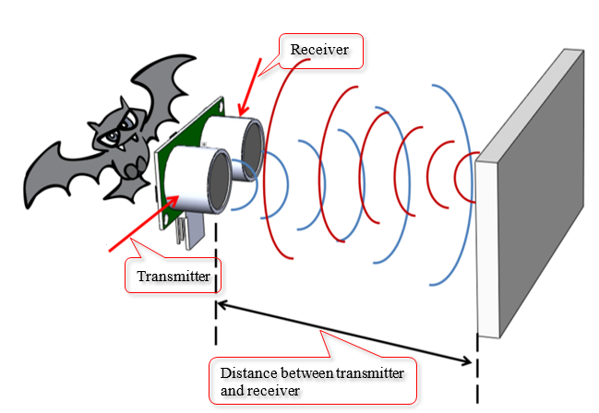
Ultrasonic Sensor
Working Principle:

Slide 25
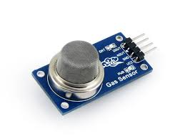
Smoke Sensor
Smoke sensor module is a device that detects
smoke and also used for the indication of fire. It
indicates the smoke by voltage level. It can also
detect LPG, propane, methane, alcohol
and hydrogen.

Slide 26

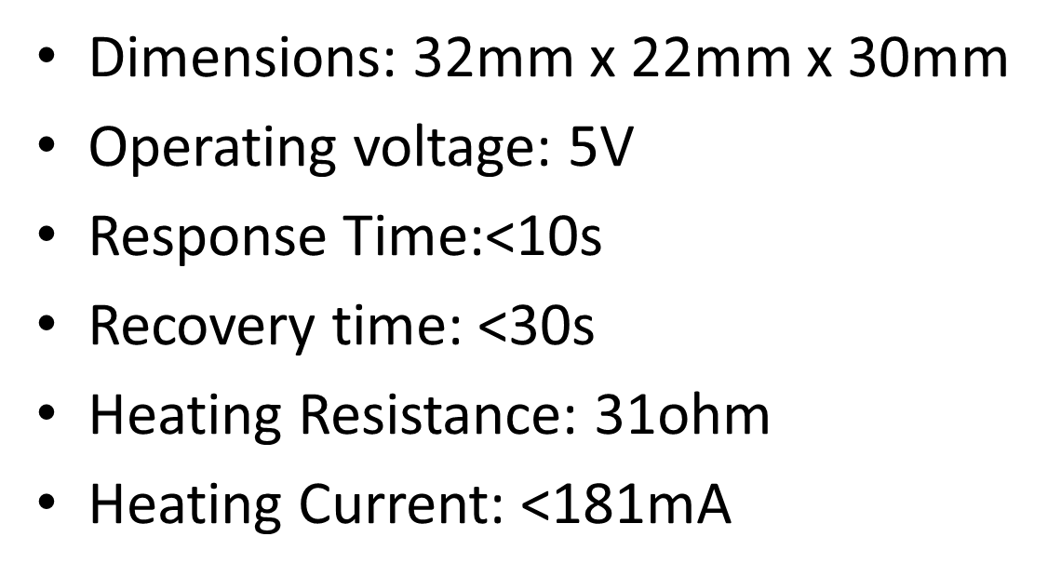
Smoke Sensor
Dimensions: 32mm x 22mm x 30mm
Operating voltage: 5V
Response Time:<10s
Recovery time: <30s
Heating Resistance: 31ohm
Heating Current: <181mA

Slide 27
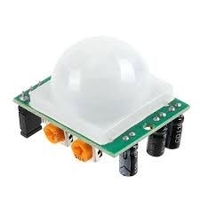
PIR Sensor
PIR sensor is a sensor which allows
us to detect the motion of human
moves in or out of the sensor range.
They are also often referred to as
PIR, "Passive Infrared", or "IR
motion" sensors.

Slide 28
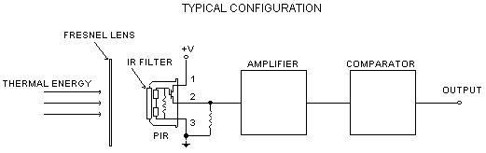
PIR Sensor
Working Principle:

Slide 29
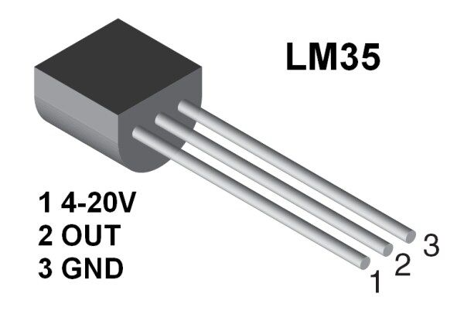
Temperature Sensor
Temperature is the most-often measured
physical quantity. It can affect chemical,
biological, electrical and many other systems.
For temperature measurement, we used LM35
module.

Slide 30


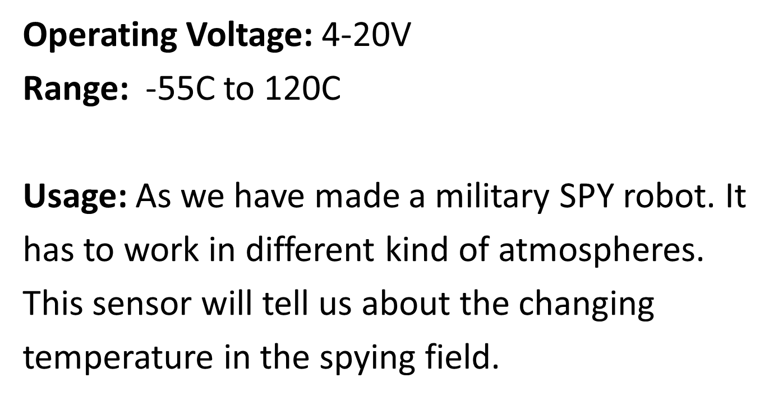
Temperature Sensor
Operating Voltage: 4-20V
Range: -55C to 120C
Usage: As we have made a military SPY robot. It
has to work in different kind of atmospheres.
This sensor will tell us about the changing
temperature in the spying field.

Slide 31

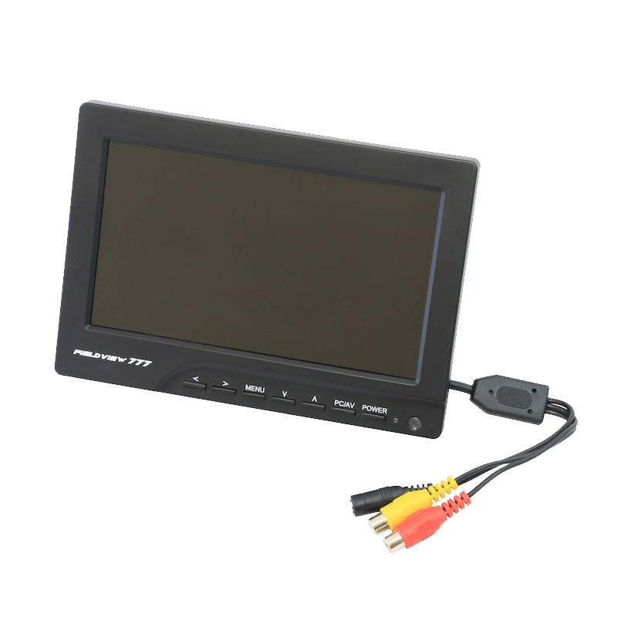
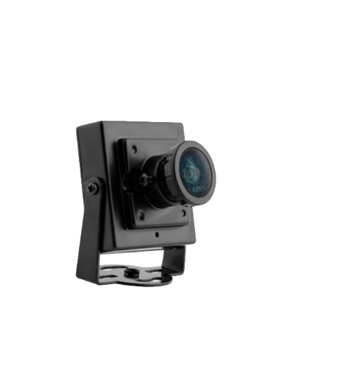
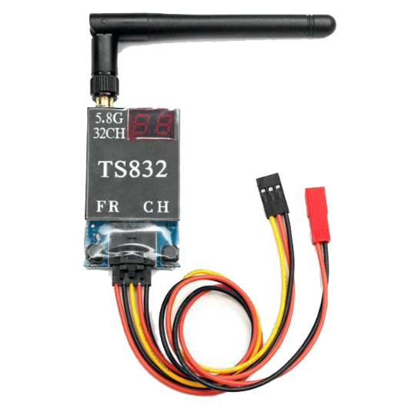
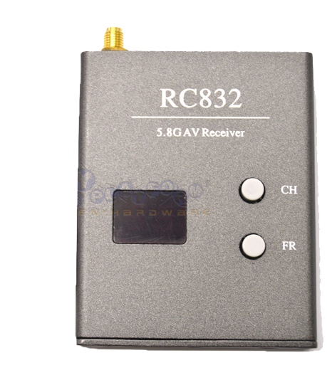
FPV Wireless Module
Purpose
Details

Slide 32

TS-832 RS-832
Features:
• 48 channels: Cover A, B, E,F,H bands and L bands
• Two switching buttons for the band and channel
• Two digits display for the band and channel
• dual Independent video and audio signal outputs

Slide 33
Specs:
Video format supported: NTSC/PAL
Antenna connection: RP-SMA, jack
Power input: 12V
Working current: 200mA max
Antenna impedance: 50Ω
Antenna gain: 2db
Rx sensitivity -90dBm
Video impedance: 75Ω

Slide 34

MIT app inventor app
Arduino code

Slide 35


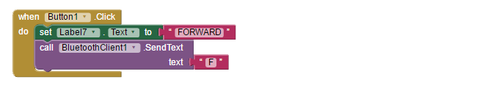
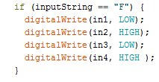
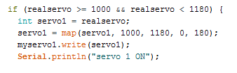
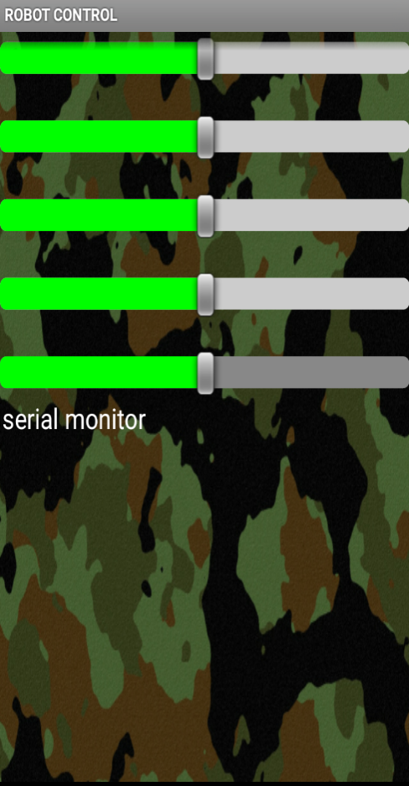
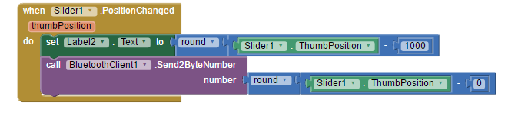
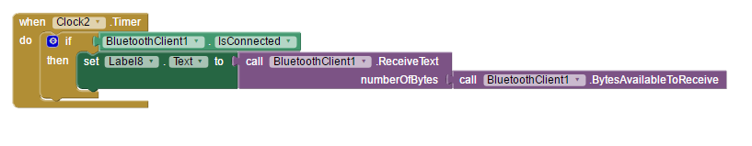

Slide 36

Strategy implementation

Slide 37

Strategy implementation
Literature review
Test the components
One by one simulation
Searching for design
Buying components
Assemble components
Evaluate design
Evaluate the component cost
Test assembled hardware
Finalize design
Searching for components
Finalize

Slide 38
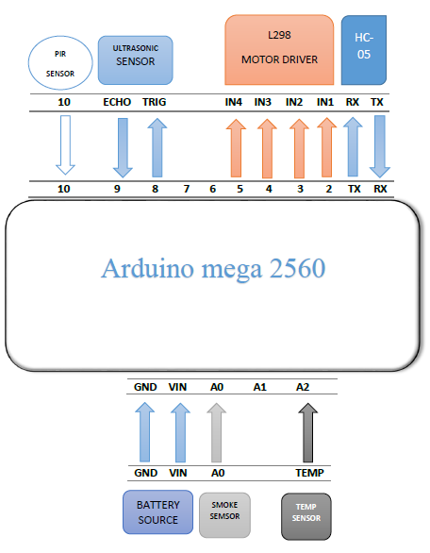
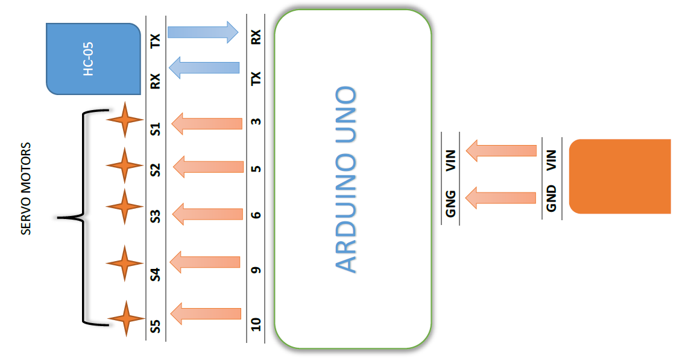
CONNECTION DIAGRAM

Slide 39

FURTHER APPLICATIONS
House keeper
Assist fire fighting
Office and industry surveillance
E-vigilanat for ware house

Slide 40

FUTURE ENHANCEMENT
Increase range
Night vision camera
Wireless charging
Enhance the efficiency of solar panel
Save video
Face detection using image processing
Use extendable arm

Slide 41
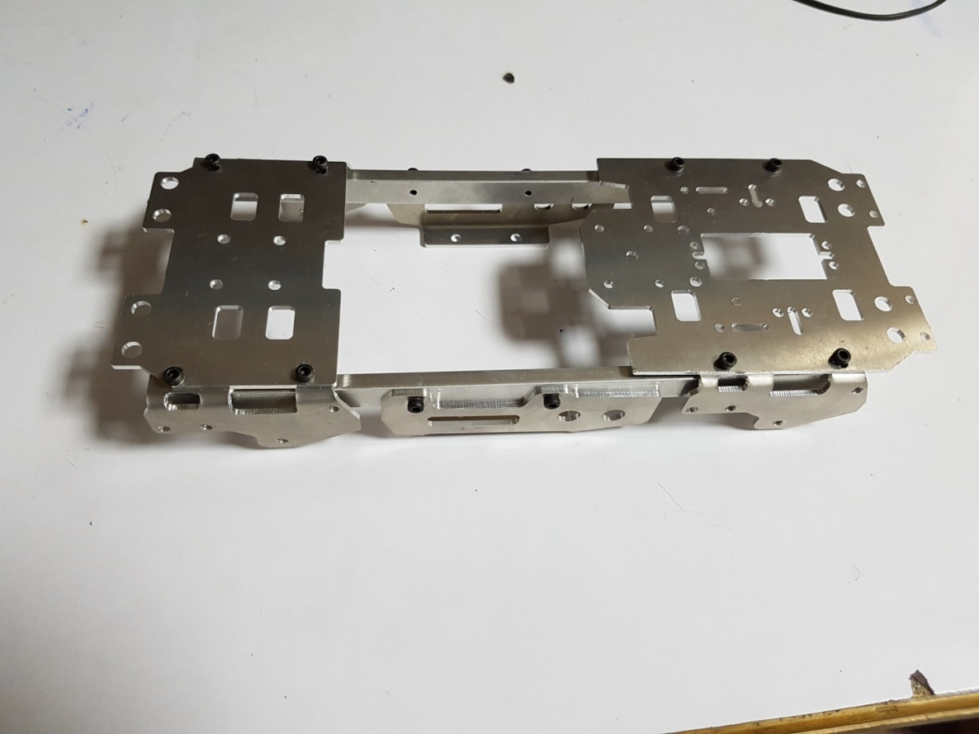
Some photos during and after implementation

Slide 42
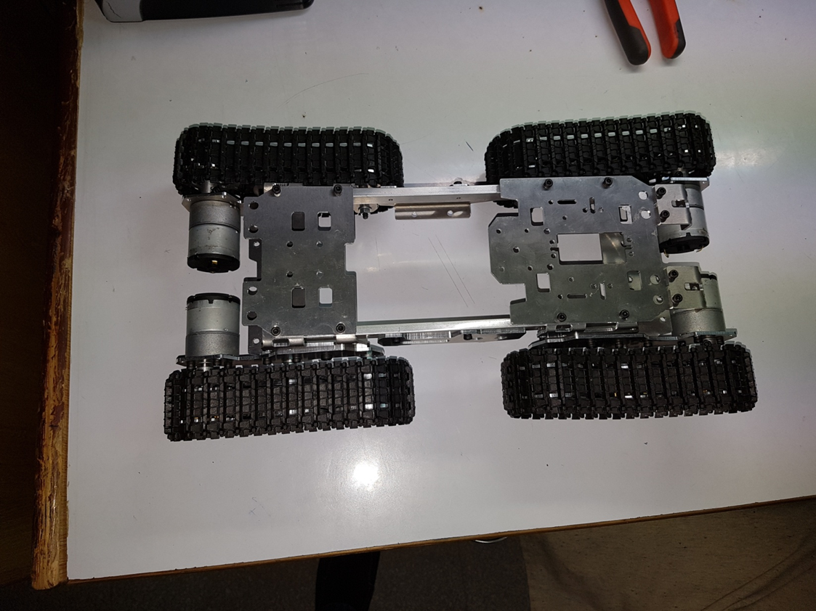
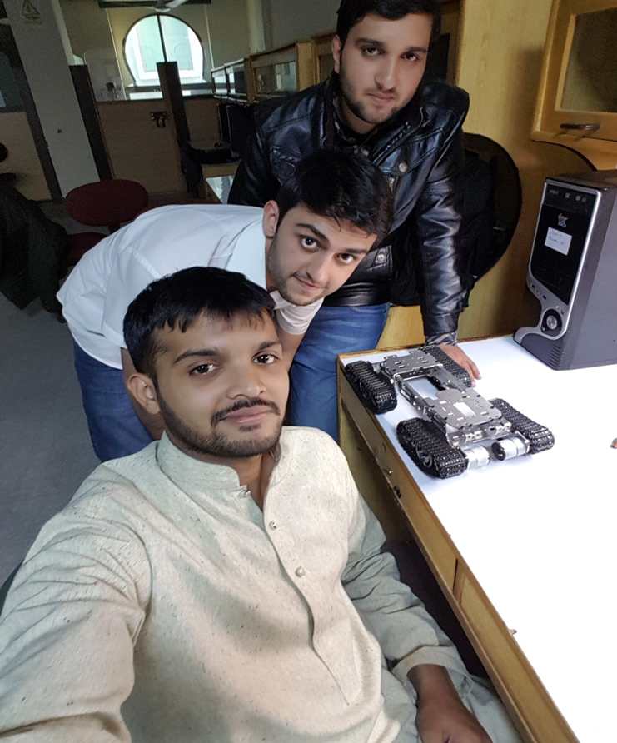
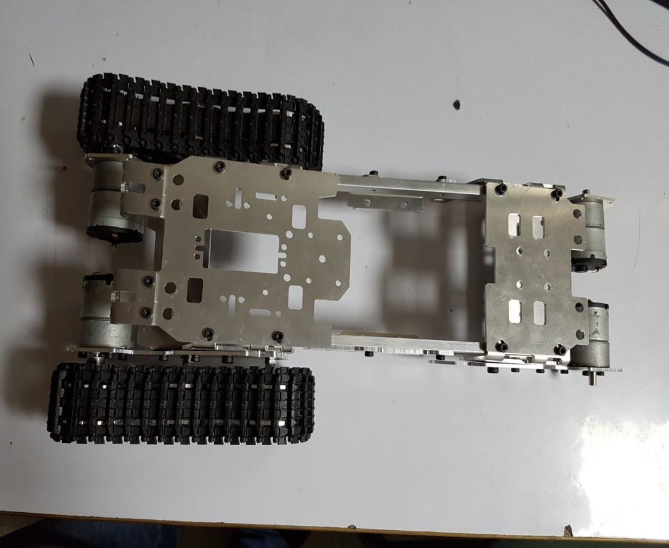

Slide 43
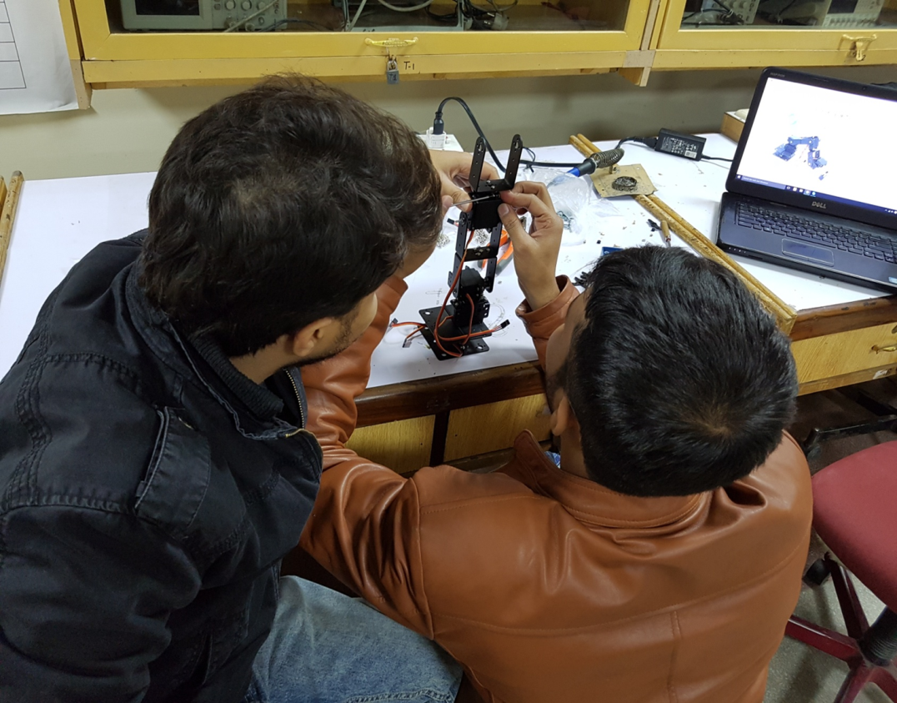
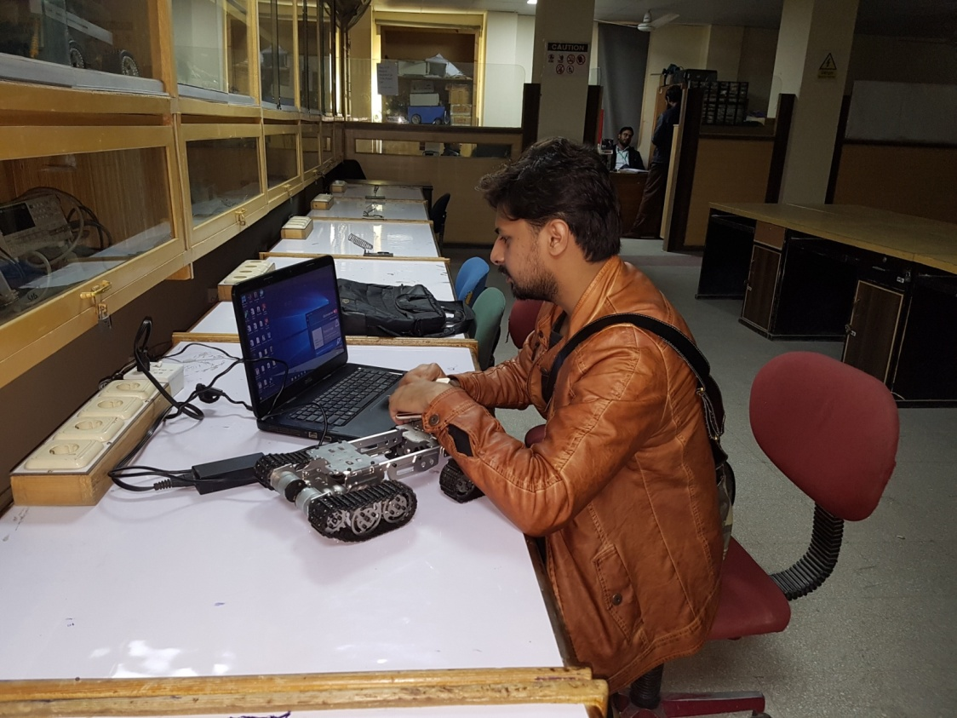
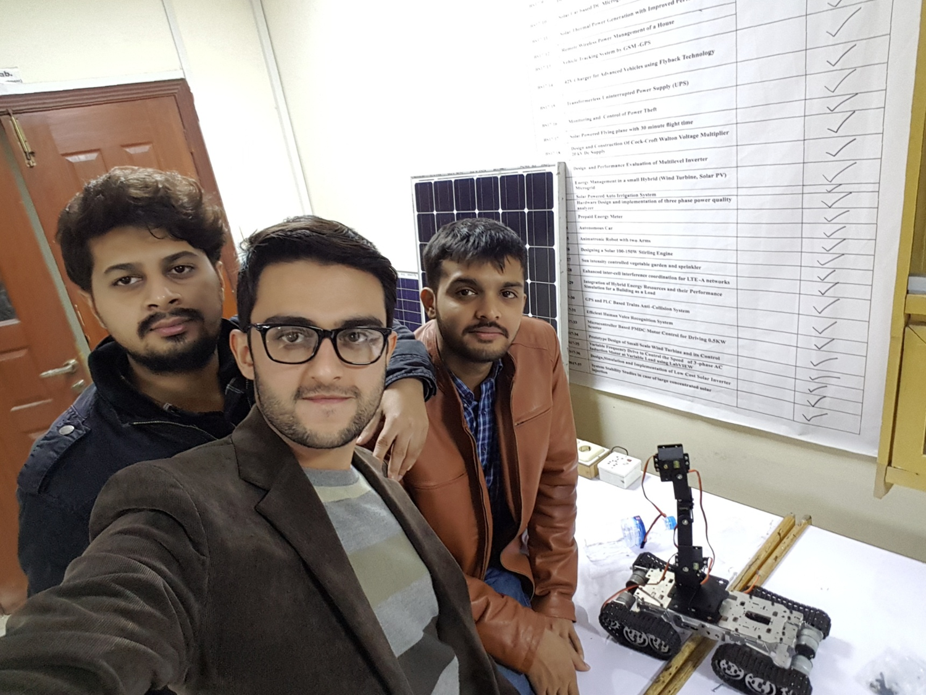

Slide 44
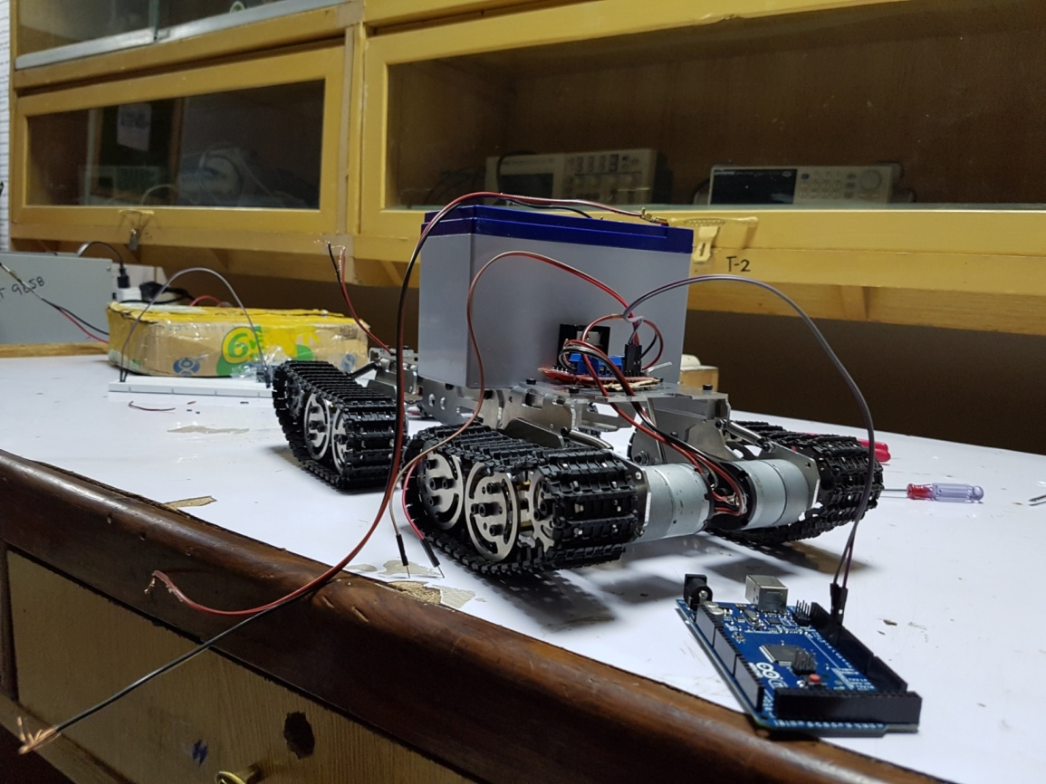
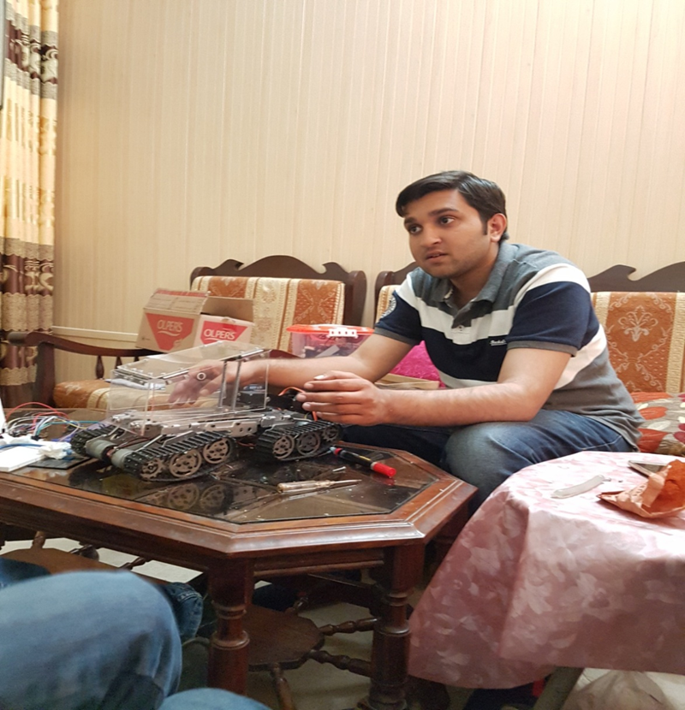
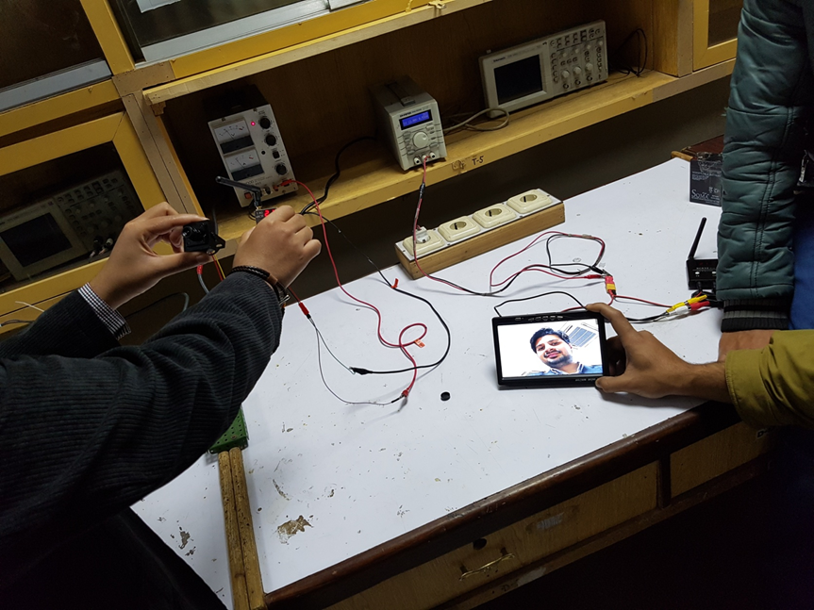
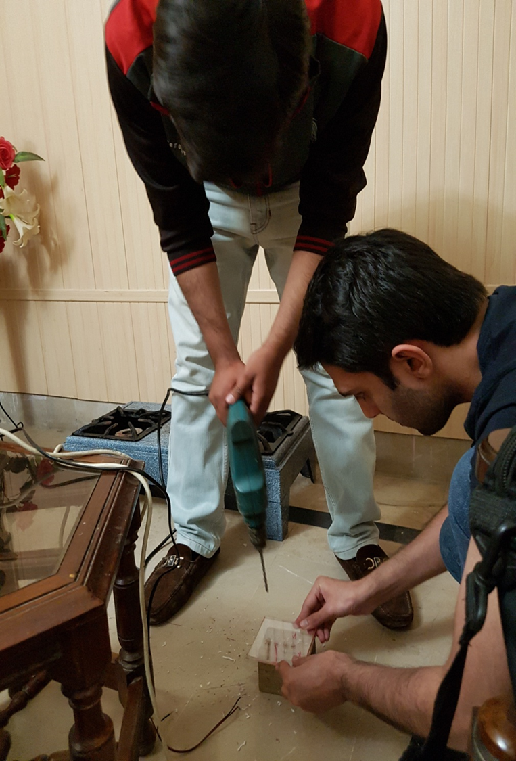

Slide 45
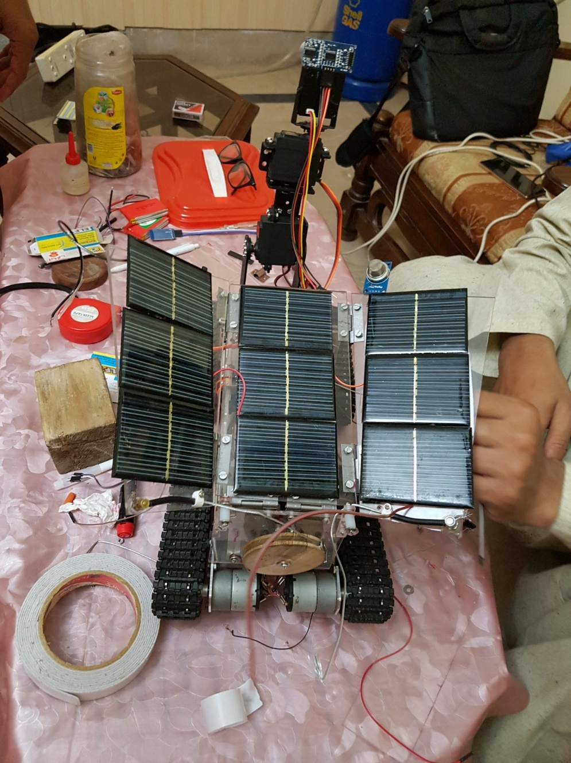


Slide 46


Slide 47


Slide 48

WON SECOND PRIZE IN APEX 2017 IN GCU
INTER UNIVERSITIES COMPETITION

Slide 49
References
http://ecomputernotes.com/computernetworkingnotes/communication-networks/bluetooth
http://www.engineersgarage.com/electronic-components/rf-module-transmitter-receiver
http://www.thegreenage.co.uk/tech/types-of-solar-panel/
https://www.aliexpress.com/item/new-WST-Enhanced-Edition-Tank-chassis-crawler-chassis-Climbing-obstacle-for-Crawler-robot-Model-Smart-Tank/32615508257.html?spm=2114.13010608.0.0.qu3Kws

Slide 50
References
https://www.aliexpress.com/item/DIY-6-DOF-3D-Rotating-Mechanical-Robot-Arm-Kit-for-Smart-Car/32596406524.html?spm=2114.13010608.0.0.qu3Kws
https://www.arduino.cc/en/Main/arduinoBoardMega
http://handyboard.com/hb/faq/hardware-faqs/dc-vs-servo/
http://www.learningaboutelectronics.com/Articles/MQ-2-smoke-sensor-circuit-with-arduino.php
https://www.elprocus.com/temperature-sensors-types-working-operation

Slide 51


